Slide 1
Lecture 13
Principles of Coarse Graining

Slide 2
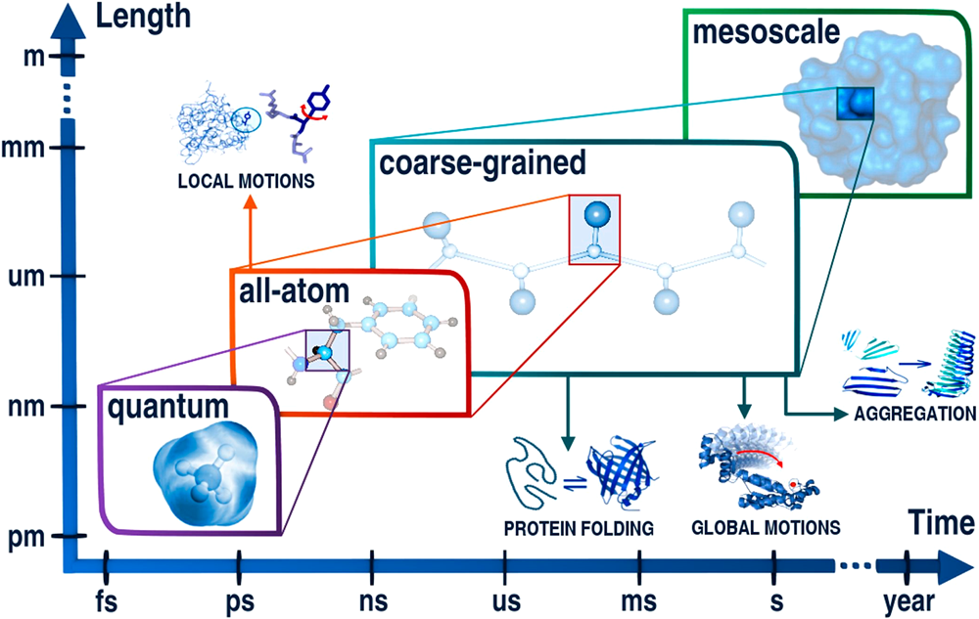
Levels of description vs. time- and size-scales
S. Kmiecik et al., Chem. Rev., 116, 7898–7936 (2016)

Slide 3
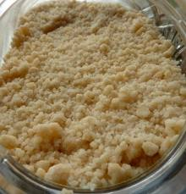
What is coarse-graining?
coarse-grained - composed of or covered with particles resembling meal in texture or consistency; "granular sugar"; "the photographs were grainy and indistinct"; "it left a mealy residue" of textures that are rough to the touch or substances consisting of relatively large particles; "coarse meal"; "coarse sand"; "a coarse weave"
coarse-grained - not having a fine texture; "coarse-grained wood"; "large-grained sand"- of textures that are rough to the touch or substances consisting of relatively large particles; "coarse meal"; "coarse sand"; "a coarse weave"
Based on WordNet 3.0, Farlex clipart collection. © 2003-2011 Princeton University, Farlex Inc.

Slide 4
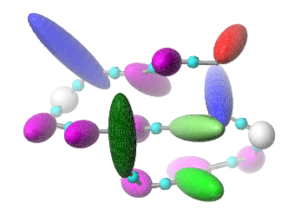
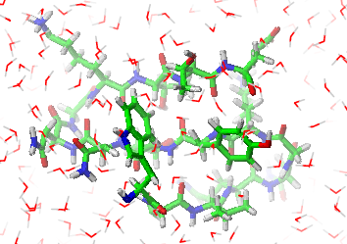
In Physics, Molecular Science, Molecular Modeling:
Coarse graining: reducing the representation of a system or a phenomenon.
Physicists prefer the term renormalization.

Slide 5
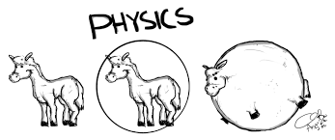
Take care while coarse-graining large objects. You probably don’t want your results be like that.

Slide 6
What is a “force field”?
A force field is a set of formulas (usually explicit) and parameters to express the conformational energy of a given class of molecules as a function of coordinates (Cartesian, internal, etc.) that define the geometry of a molecule or a molecular system. A force field is an approximation to the Potential Energy Surface (PES) of a system.
Features:
Cheap
Fast
Easy to program
Restricted to conformational analysis (no chemical reactions)
Non-transferable
Results sometimes unreliable

Slide 7
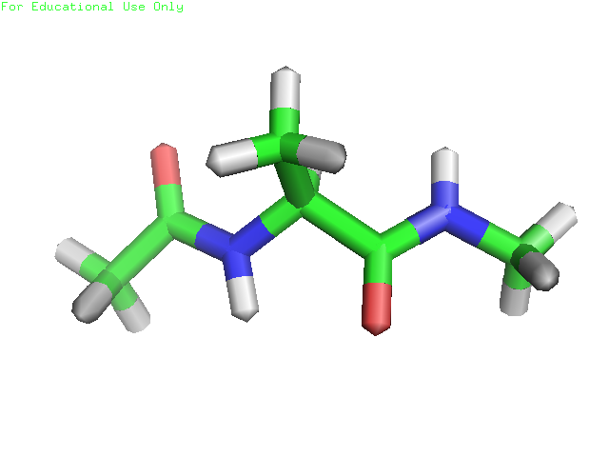
All-atom empirical force fields: a very simplified representation of the potential energy surfaces

Slide 8
Some force fields commonly applied in all-atom biomolecular simulations
Name | Authors/references
AMBER/OPLS | Weiner et al., 1984; 1986; Cornell et al., 1995; Jorgensen et al., 1996 http://ambermd.org/
CHARMm | Brooks et al., 1983; MacKerrel et al., 1998; 2001 http://www.charmm.org/
GROMOS/GROMACS | van Gunsteren & Berendsen, 1987; Scott et al., 1999 http://www.gromos.net/
DISCOVER (CVFF) | Dauber-Osguthorpe, 1988; Maple et al., 1998

Slide 9
Applications of force fields
Technique | Application
Local minimization | Refinement
Global minimization | Searching most stable (?) structures
Monte Carlo methods | Thermodynamical properties, ensemble averages
Molecular dynamics and extensions
 | Dynamical properties

Slide 10
Coarse-grained force fields (potentials): a general formula
Local terms
Pairwise terms
Multibody terms

Slide 11
Advantages and problems of coarse-graining
Over 1000-fold increase of the time scale of simulations.
Very large systems can be treated.
Results are easier to analyze compared to those of all-atom simulations.
Effective energy functions difficult to construct.
Restricted tranferability of effective energy expressions and parameters.
No exact relationship of the CG time scales and real/all-atom time scales.

Slide 12
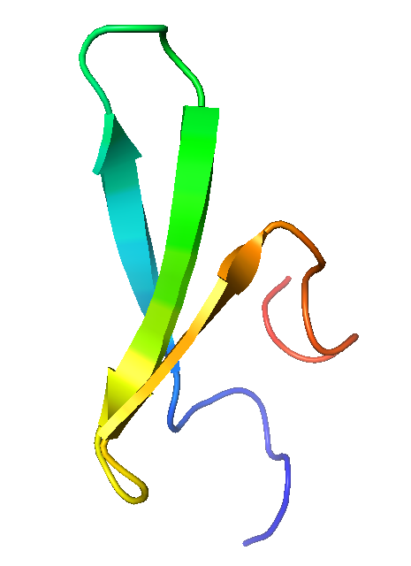
CG vs. laboratory time scale
Simulated rate constants: ns⁻¹
Experimental rate constants: μs⁻¹.
Simulation of the kinetics of the folding FBP-28 WW domain variants with UNRES.
Zhou et al. Proc. Natl. Acad. Sci. USA, 2014, 111, 18243 (simulations).
Nguyen et al., Proc. Natl. Acad. Sci. U.S.A., 2003, 100, 3948 (experimental).

Slide 13
Types of coarse-grained potentials
Physics-based potentials
  smoothing the energy surface by treating rigid objects as single interaction sites (e.g., the Kihara potentials),
  averaging out non-essential degrees of freedom,
  reproducing thermodynamic properties of small compounds.
Statistical potentials based on the „Boltzmann principle”
  database information implicit in the potentials,
  database information explicit in the potentials.
Arbitrary potentials (HP, HNP).
Structure-based potentials
  native secondary structure or other components of structure built in the potentials
  the native structure is the global minimum (Gō-like potentials).
Elastic network potentials.

Slide 14
Examples of pragmatic coarse-grained models
Force field | Type | Applications
AWSEM (Papoian, Wolynes) | Physics-based | Protein-structure prediction, prediction of protein-protein complexes, dimerization interfaces, and aggregation. https://github.com/adavtyan/awsemmd
CABS/SURPASS (Koliński et al.) | Statistical | Protein-structure prediction, simulations of protein dynamics, protein-protein and protein-ligand docking, proteins in lipid environment. https://biocomp.chem.uw.edu.pl/tools
SimRNA (Bujnicki et al.) | Statistical | RNA structure prediction http://genesilico.pl/software/stand-alone/simrna
MARTINI (Marrink et al.) | Physics-based | Dynamics of proteins, lipids, nucleic acids, poly-saccharides, includes small molecules. http://cgmartini.nl/
OPEP/HiRe-RNA (Derreumaux et al.) | Physics-based | Structure and dynamics of proteins and nucleic acids. http://www-lbt.ibpc.fr/
UNICORN (UNRES, NARES-2P, SUGRES-1P) | Physics-based | Protein-structure prediction, simulations of protein dynamics, protein-protein docking, DNA/RNA folding/hybridization and dynamics. www.unres.pl
A comprehensive review: Kmiecik et al., Chem. Rev., 2016, 116, 7898–7936,
A more recent review: Borges-Araujo et al., J. Chem. Theory Comput. 2023, 19, 7112-7135

Slide 15
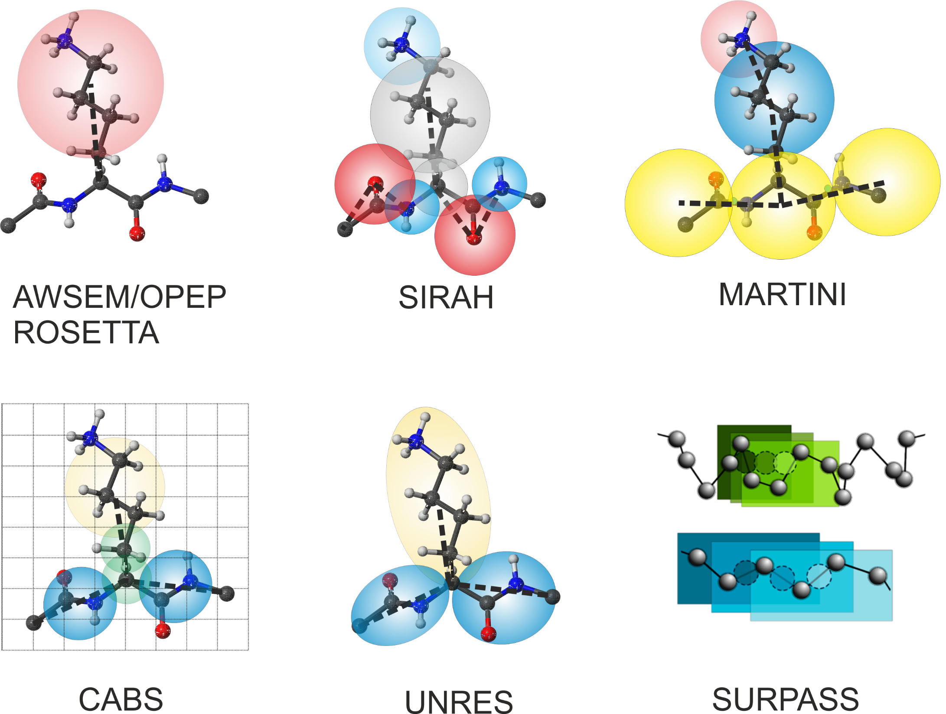

Slide 16
Prototype of the effective energy function (U) in physics-based coarse-grained modeling
F: Restricted Free Energy (RFE); Potential of Mean Force (PMF)

Slide 17
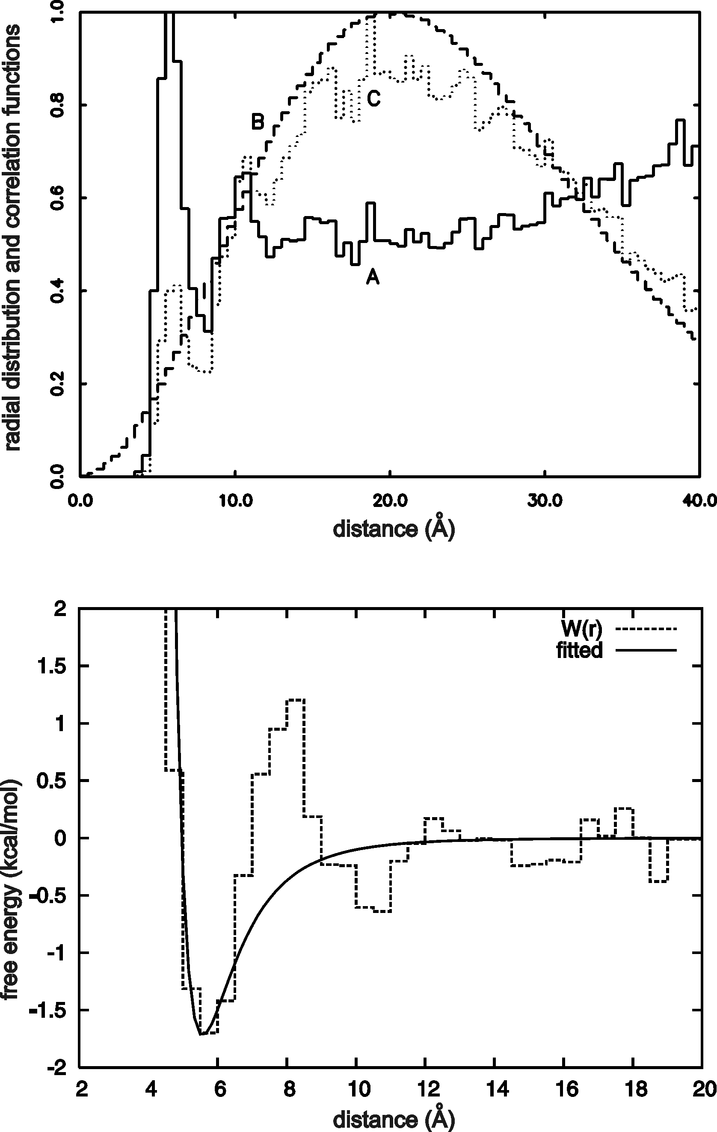
Statistical potentials
x – geometric variable
p – type(s) of site(s)
s – sequence context
Leu-Leu pair, statistics from PDB

Slide 18
The CABS model
Koliński, Acta Biophys. Pol., 2004, 51, 349-371

Slide 19
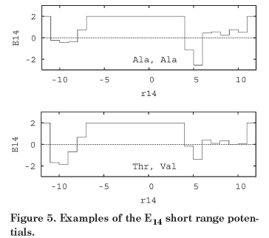
The CABS model: local and hydrogen-bonding potentials
Koliński, Acta Biophys. Pol., 2004, 51, 349-371

Slide 20
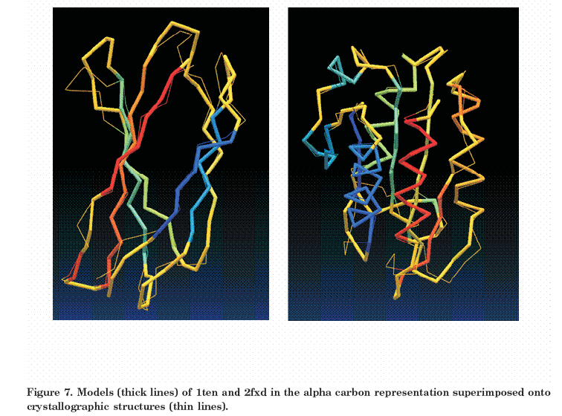
Examples of protein-structure modeling with CABS
Koliński, Acta Biophys. Pol., 2004, 51, 349-371

Slide 21
CABS references
A. Koliński, A. Godzik, J. Skolnick, J. Chem. Phys., 98, 7420-7433 (1993) (the first version of the model, not yet CABS).
A Koliński, J. Skolnick, Proteins Struct. Funct. Genet., 18, 338-352; 353-366 (1994) (more about the model and preliminary application).
A. Koliński, Acta Biochim. Polon., 51, 347-351 (2004) (description of the CABS model).
S. Kmiecik, M. Kurcinski, A. Rutkowska, D. Gront, A. Kolinski, Acta Biochim. Polon., 53, 131–143 (2006) (denaturated states by CABS).
D. Gront, A. Koliński, Bioinformatics, 22, 621–622, 2006 (BioShell)
D. Latek, A. Koliński , J. Comput. Chem., 32, 536–44, (2011) (CABS-NMR)
M. Jamroż, A. Koliński, S. Kmiecik , Nucl. Acids Research, 41, W427-W431 (2013) (CABS Flex server)
M. Błaszczyk, M. Jamroż, S. Kmiecik, A. Koliński Nucl. Acids Research, 41, W406-W411, (2013) (CABS Fold server)
M. Kurciński, M. Jamroż, M. Błaszczyk, A. Koliński, S. Kmiecik Nucl. Acids Research, 43 (W1):W419-W424 (2015) (CABS Dock server).

Slide 22
Physics-based coarse-grained potentials: Expressing the total PMF
Sum of neo-classical (all-atom-like) expressions (Levitt & Warshel, 1975; Levitt, 1976; MARTINI force field)
Expansion in radial basis functions and force matching (Voth and coworkers, 2007)
Expansion in Kubo cluster cumulant functions or factor expansion (UNRES)
Application of machine learning to derive the potentials. This approach also pertains to statistical potentials, an EXTREMELY successful example is AlphaFold. However, a dark side of machine learning is that a derived force field is beyond our comprehension and, therefore, we less and less are able to judge how they work and whether they work well or produce crap.

Slide 23
Sum of neo-classical terms

Slide 24
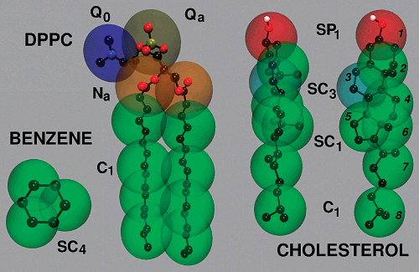
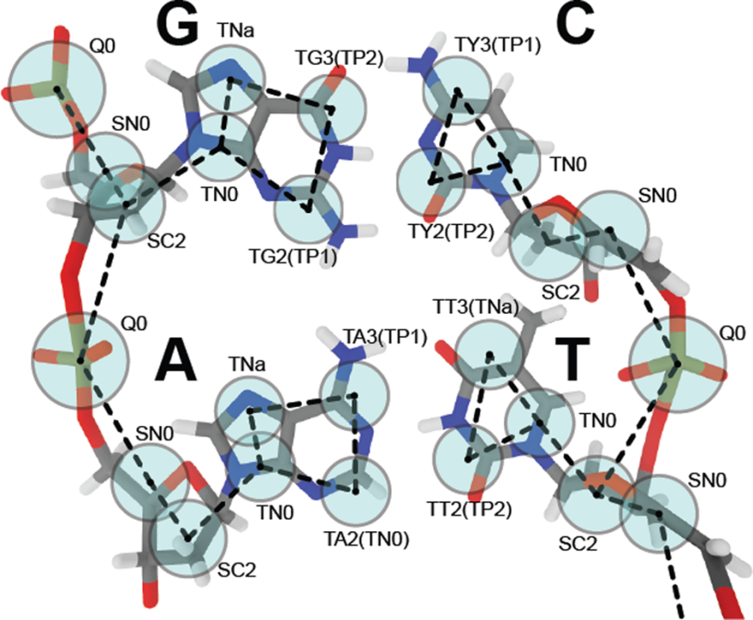
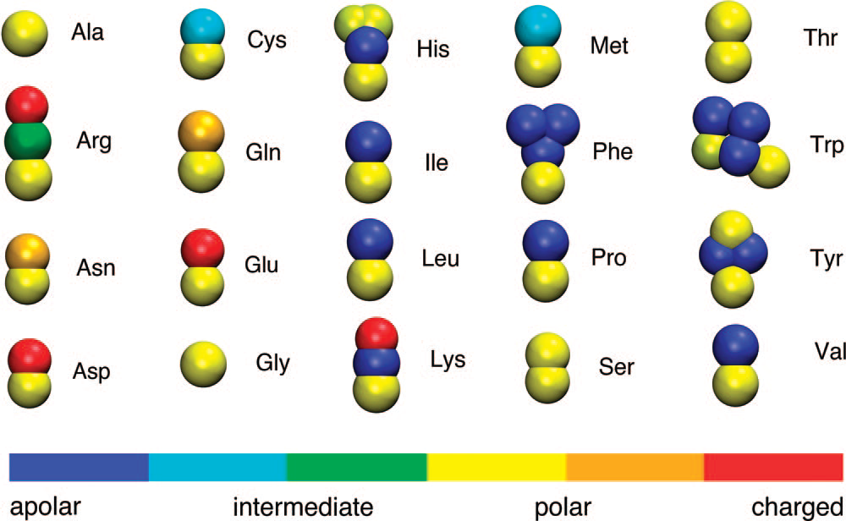
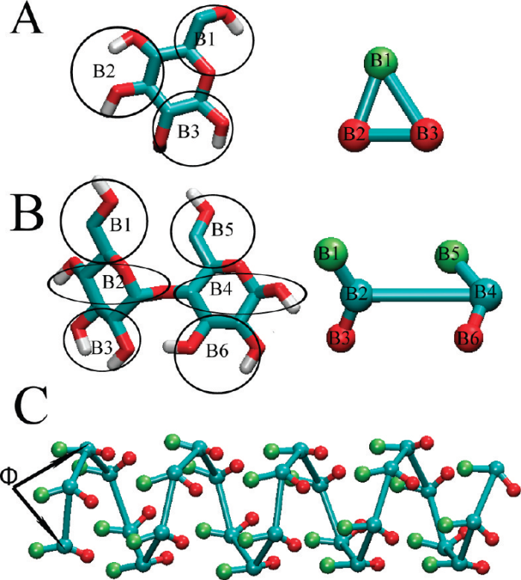
The MARTINI force field

Slide 25
Showcase of Martini
(Borges-Araujo et al., J. Chem. Theor. Comput., 2023, 19, 7112-7135)

Slide 26
MARTINI references
S.-J. Marrink et al., J. Phys. Chem. B 2007, 111, 7812-7824 (lipids)
L. Monticelli et al., J. Chem. Theory and Comput. 2008, 4, 819–834 (proteins)
C.A. Lopez et al., J. Chem. Theory Comput. 2009, 5, 3195–3210 (carbohydrates)
J.J. Uusitalo et al., J. Chem. Theory Comput. 2015, 11, 3932−3945 (DNA)
C. Arnarez et al., J. Chem. Theory Comput. 2015, 11, 260−275 („dry” Martini; implicit sovent)
S.-J. Marrink and D.P. Tieleman, Chem. Soc. Rev., 2013, 42, 6801-6822 (overview and perspectives)

Slide 27
The Multiscale Coarse Graining Method
(Force Matching) (Voth and coworkers)
The prototype of the CG energy function is the RFE.
Coordinates of the centers of masses of the CG sites are the CG degrees of freedom.
The sites interact with pairwise central potentials.
A force field is parameterized by least-square fitting of the CG forces to the average forces acting on the CG sites determined by MD simulations of a given system.
Explicit water (a single site per each water molecule).

Slide 28
Expansion into radial functions and force matching
Each dφ/dr_{IJ} is represented by values on a grid in r_{IJ,,} a spline, or as a linear combination of analytical functions. The values on the grid or the coefficients of spline/analytical function are determined by solving a linear least—squares problem. Afterwards, the φ’s are obtained by integrating dφ/dr over r.

Slide 29
The coarse-grained forces (a) and the potentials (b) for the water-water interaction. The iterative force matching curves are in black, while the MS-CG results are in red.
Lu et al., J. Chem. Phys., 2013, 139, 121906

Slide 30
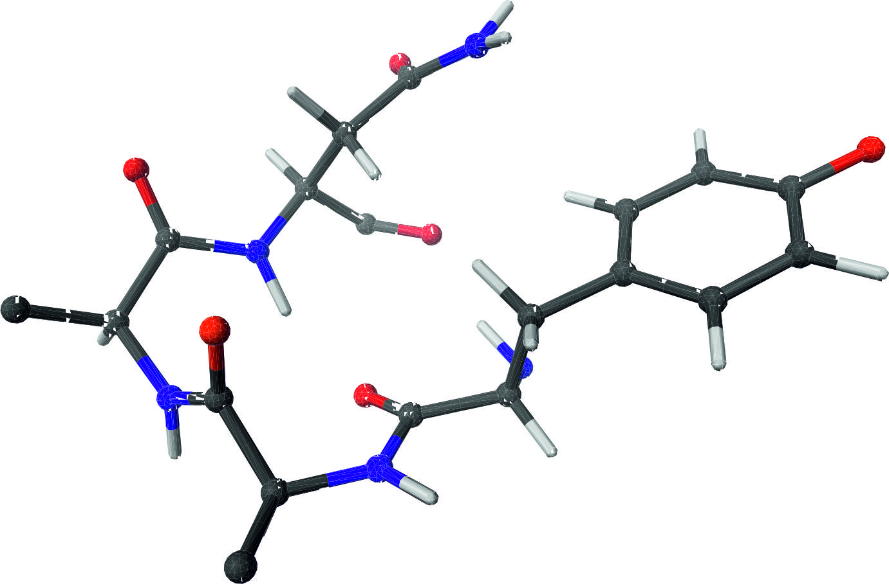
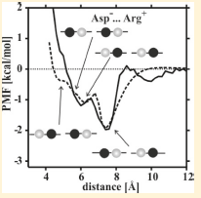
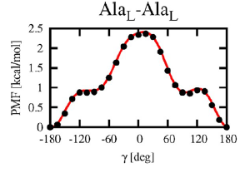
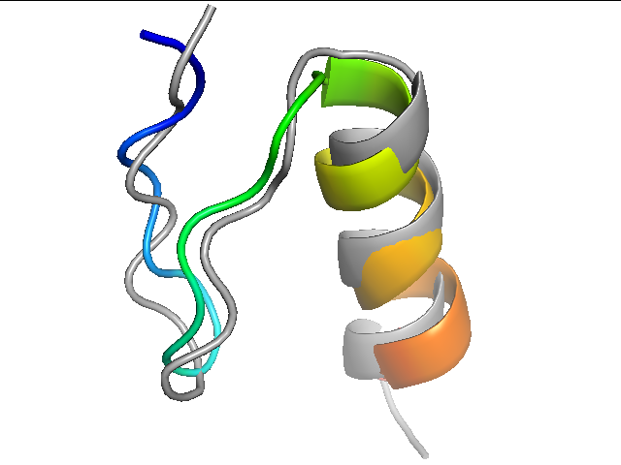
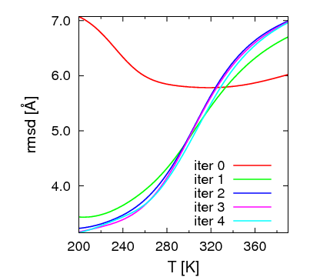
PMF expansion into factors: Scheme of CG force field construction
Define CG interaction sites and d.o.f’s
Partition the energy site-wise
Split the PMF: define effective energy terms
Derive scale- and geometry-consistent analytical expressions
Parameterize energy terms
Calibrate CG force field

Slide 31
Factorization of the PMF into Kubo cluster cumulant functions
‘classical’
correlation, order 2
correlation, order 3
correlation, order N-1
…
A. Liwo, C. Czaplewski, H.A. Scheraga, J. Chem. Phys., 115, 2323-2347 (2001).

Slide 32
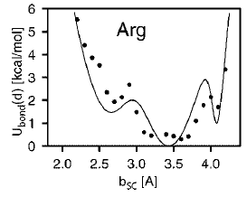
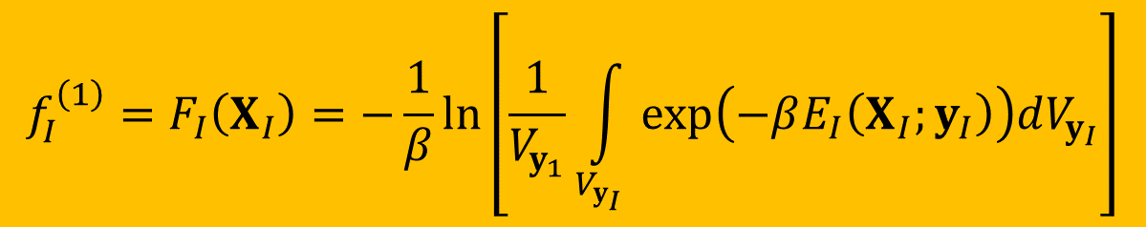
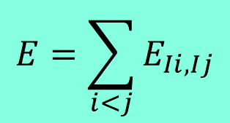
Example: factor of order 1 (f ⁽¹⁾ = F); in-site
$$E=\sum_{i<j}{E_{Ii,Ij}}$$
$$f_{I}^{\left(1\right)}=F_{I}\left(X_{I}\right)=−\frac{1}{β}\ln\left[\frac{1}{V_{y_{1}}}\int_{V_{y_{I}}}{exp\left(−βE_{I}\left(X_{I};y_{I}\right)\right)dV_{y_{I}}}\right]$$

Slide 33
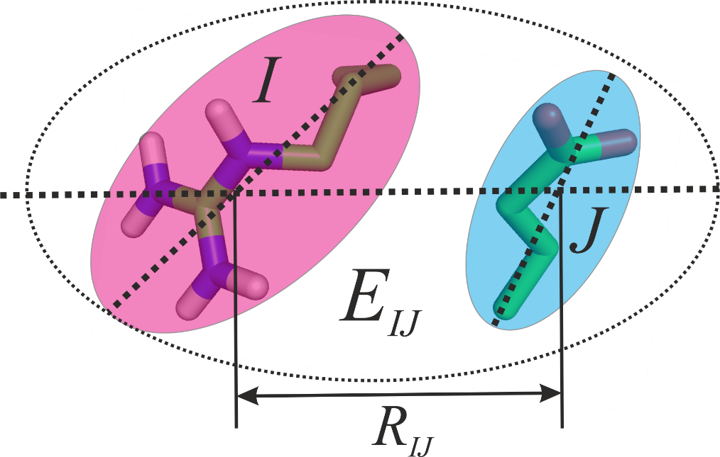
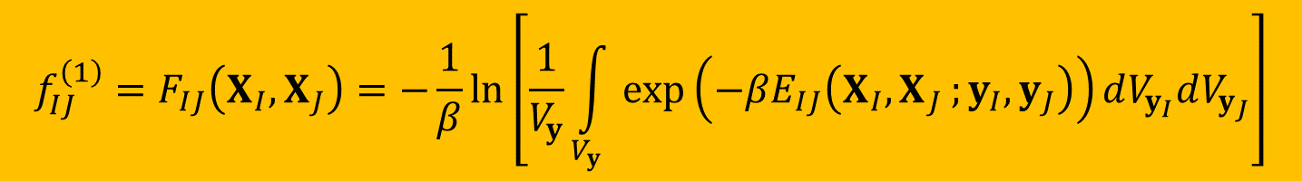
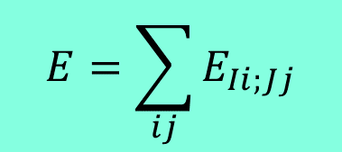
Example: factor of order 1 (f ⁽¹⁾ = F); between sites
$$E=\sum_{ij}{E_{Ii;Jj}}$$
$$f_{IJ}^{\left(1\right)}=F_{IJ}\left(X_{I},X_{J}\right)=−\frac{1}{β}\ln\left[\frac{1}{V_{y}}\int_{V_{y}}{exp\left(−βE_{IJ}\left(X_{I}{,X}_{J};y_{I},y_{J}\right)\right)dV_{y_{I}}dV_{y_{J}}}\right]$$

Slide 34
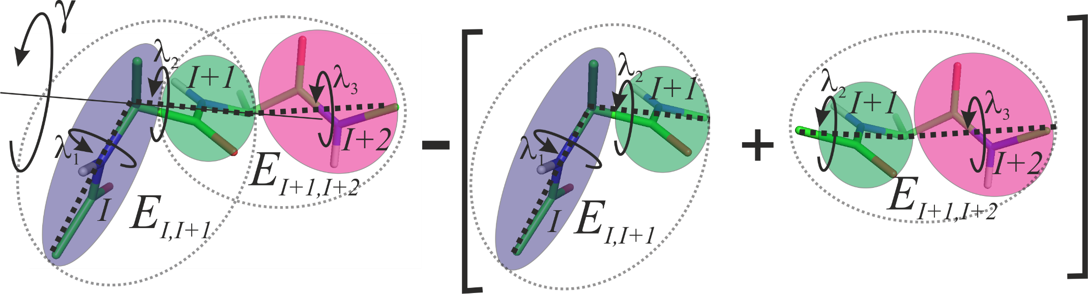
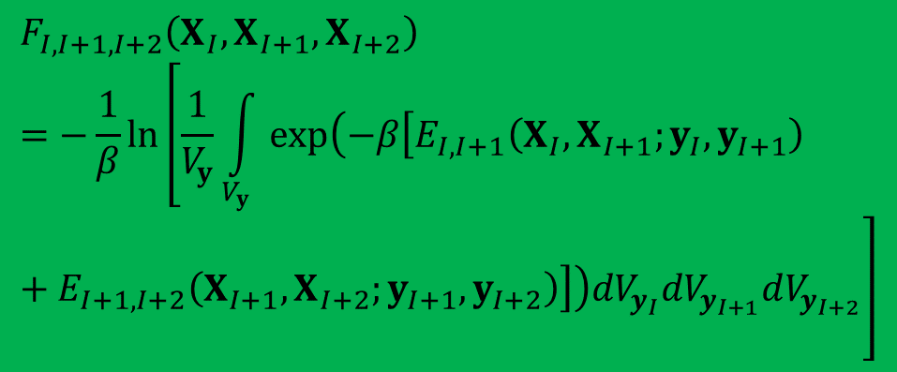
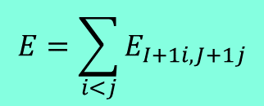
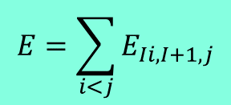
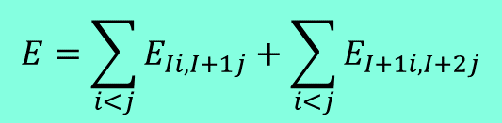
Example: factor of order 2 (torsional potential)
$$E=\sum_{i<j}{E_{Ii,I+1j}}+\sum_{i<j}{E_{I+1i,I+2j}}$$
$$E=\sum_{i<j}{E_{Ii,I+1,j}}$$
$$E=\sum_{i<j}{E_{I+1i,J+1j}}$$
$$f_{I,I+1,I+2}^{\left(2\right)}=F_{I,I+1,I+2}\left(X_{I},X_{I+1},X_{I+2}\right)−\left[F_{I,I+1}\left(X_{I},X_{I+1}\right)+F_{I+1,I+2}\left(X_{I+1},X_{2}\right)\right]$$
$$F_{I,I+1,I+2}\left(X_{I},X_{I+1},X_{I+2}\right)=−\frac{1}{β}\ln\left[\frac{1}{V_{y}}\int_{V_{y}}{exp\left(−β\left[E_{I,I+1}\left(X_{I},X_{I+1};y_{I},y_{I+1}\right)+E_{I+1,I+2}\left(X_{I+1},X_{I+2};y_{I+1},y_{I+2}\right)\right]\right)dV_{y_{I}}dV_{y_{I+1}}dV_{y_{I+2}}}\right]$$

Slide 35
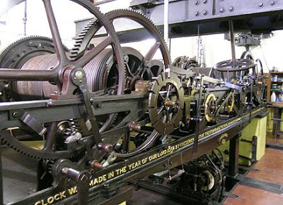
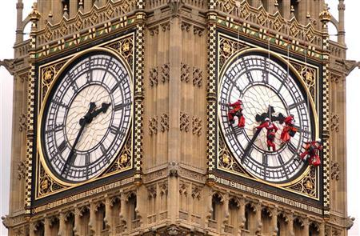

Slide 36
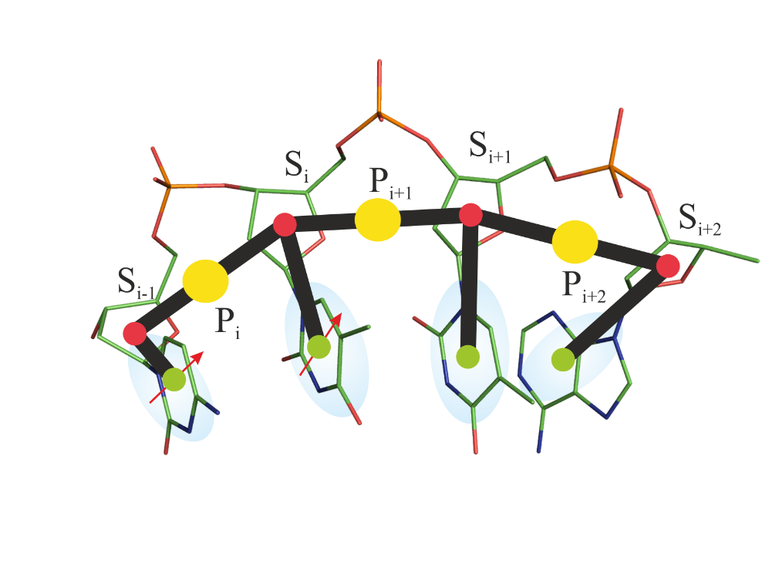
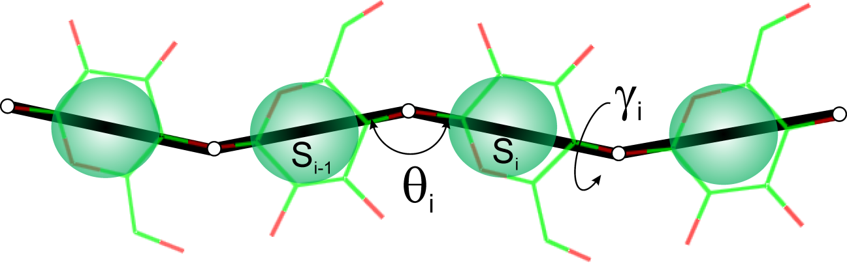
UNIfied COarse-gRaiNed model
UNICORN
NARES-2P
UNRES
SUGRES-1P
Liwo et al., J. Mol. Modeling, 20, 2306 (2014); UNRES package available from https://unres.pl

Slide 37
Showcase of UNICORN
(Borges-Araujo et al., J. Chem. Theory Comput., 2023, 19, 7112-7135)

Slide 38
UNICORN references
A. Liwo et al. A unified coarse-grained model of biological macromolecules based on mean-field multipole-multipole interactions. J. Molec. Model., 2014, 20, 2306.
M. Baranowski et al. Microscopic physics-based models of proteins and nucleic acids: UNRES and NARES, in Coarse-Grained Models of Biomolecules, ed. by G.A. Papoian, CRC Press, ISBN 9781466576063, CAT# K16726, 2017.
A. Liwo et al. Scale-consistent approach to the derivation of coarse-grained force fields for simulating structure, dynamics, and thermodynamics of biopolymers. Prog. Mol. Biol. Trans. Sci., 2020, 170, 73-121.
A. K. Sieradzan et al. Modeling the structure, dynamics, and transformations of proteins with the UNRES force field. Methods in Molecular Biology, vol. 2376, ed. by V. Munoz, Springer New York, 2022, Chapter 23, pp. 399-416.

Slide 39
UNRES and UNRES server
Description, download, instructions and more: www.unres.pl
A. Liwo et al., J. Molec. Modeling, 2014, 20
Server available
http://unres-server.chem.ug.edu.pl (Author: Czarek Czaplewski)
C. Czaplewski, A. Karczyńska, A.K. Sieradzan, A. Liwo, Nucleic Acids Research, 2018, 1, doi: 10.1093/nar/gky328 (web server issue)

Slide 40
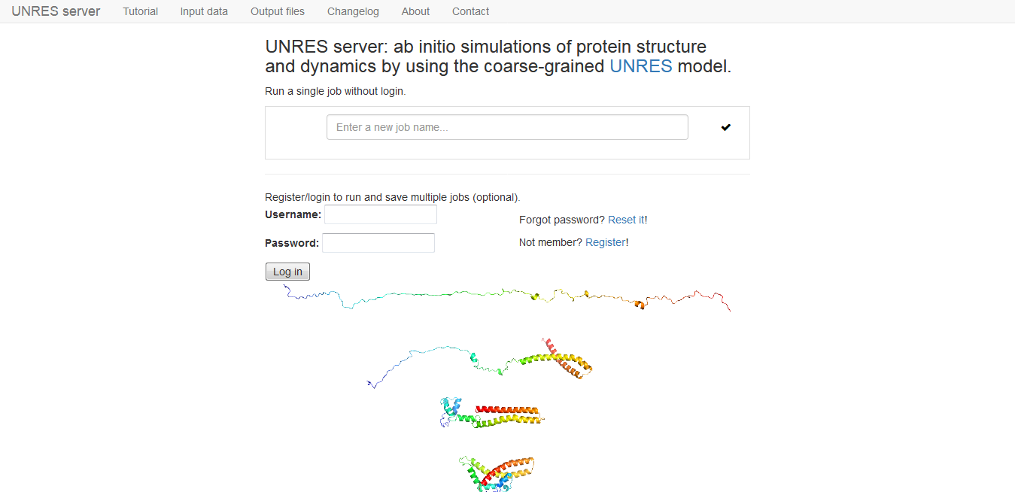
UNRES server

Slide 41
Registration
Registration is optional; jobs can be run in guest mode
To register
  Click „Register” on the main server page
  Type in your login name, password, and email address
  Check your email and when you receive the activation link, click it

Slide 42
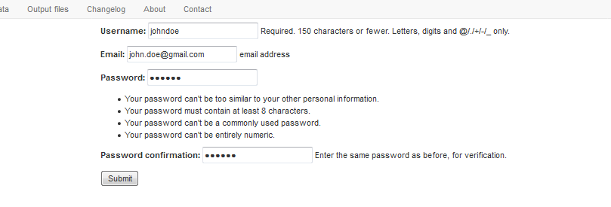

Slide 43
Running jobs
Running jobs in guest mode (no account)
  one job at a time
  user data & results kept for 2 weeks
  access to past jobs possible provided that the web address of the link to a job has been saved
Running jobs by registered users
  multiple jobs can be run simultaneously
  past jobs saved on user’s account, easily accessible.

Slide 44
Simulation types
Single energy minimization
Canonical molecular dynamics
Simulating conformational ensembles by MREMD
  Free/secondary-structure restrained simulations
  SAXS-data assisted simulations
  NMR-data-assisted simulations
  XL-MS-data-assisted simulations

Slide 45
Input data
Basic and advanced mode enabled
User-defined input
  Amino-acid sequence (one-letter code)
  Type of starting structure (extended or random)
PDB input
  Complete information (amino-acid sequence, starting and reference structure) is taken from the PDB structure
Explicit file name or PDB code (can include chain ID, e.g., G3Q:B) can be supplied to input PDB structure
Simulation parameters (optional)
Secondary-structure prediction (PSIPRED format)
SAXS, NMR, XL-MS restraints

Slide 46
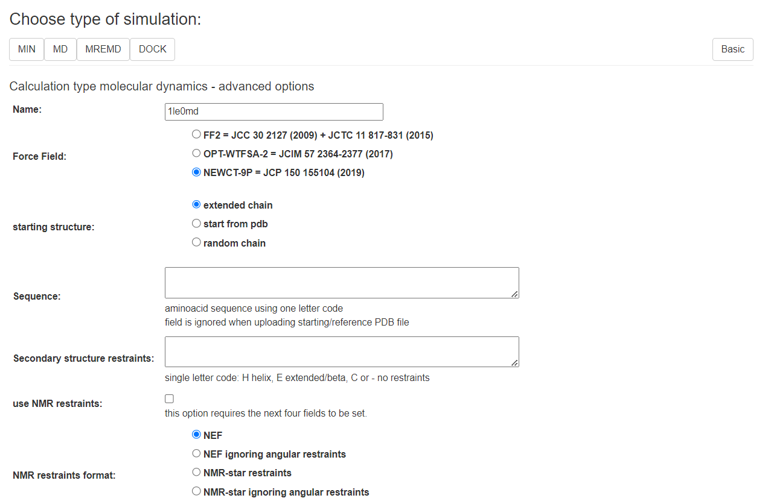
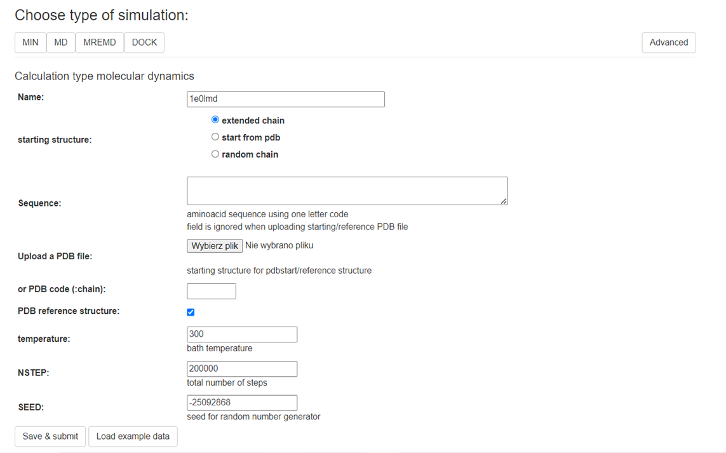
It is recommended to select the NEWCT-9P force variant of the UNRES force field, which can be selected from Advaced mode. The default is the oldr FF2 force field.

Slide 47
Systems to try
The N-terminal part of the B-domain of staphylococcal protein A (1BDD) and the FBP28WW domain (1E0L): energy minimization and canonical molecular dynamics, start from PDB structure.
Tryptophan cage (1L2Y) and tryptophan zipper (1LE0): canonical molecular dynamics and replica-exchange molecular dynamics started from random structures.

