Slide 1
Lecture 13
Coarse-Grained Models
of Biomolecules
Part II: Statistical potentials, CABS model

Slide 2
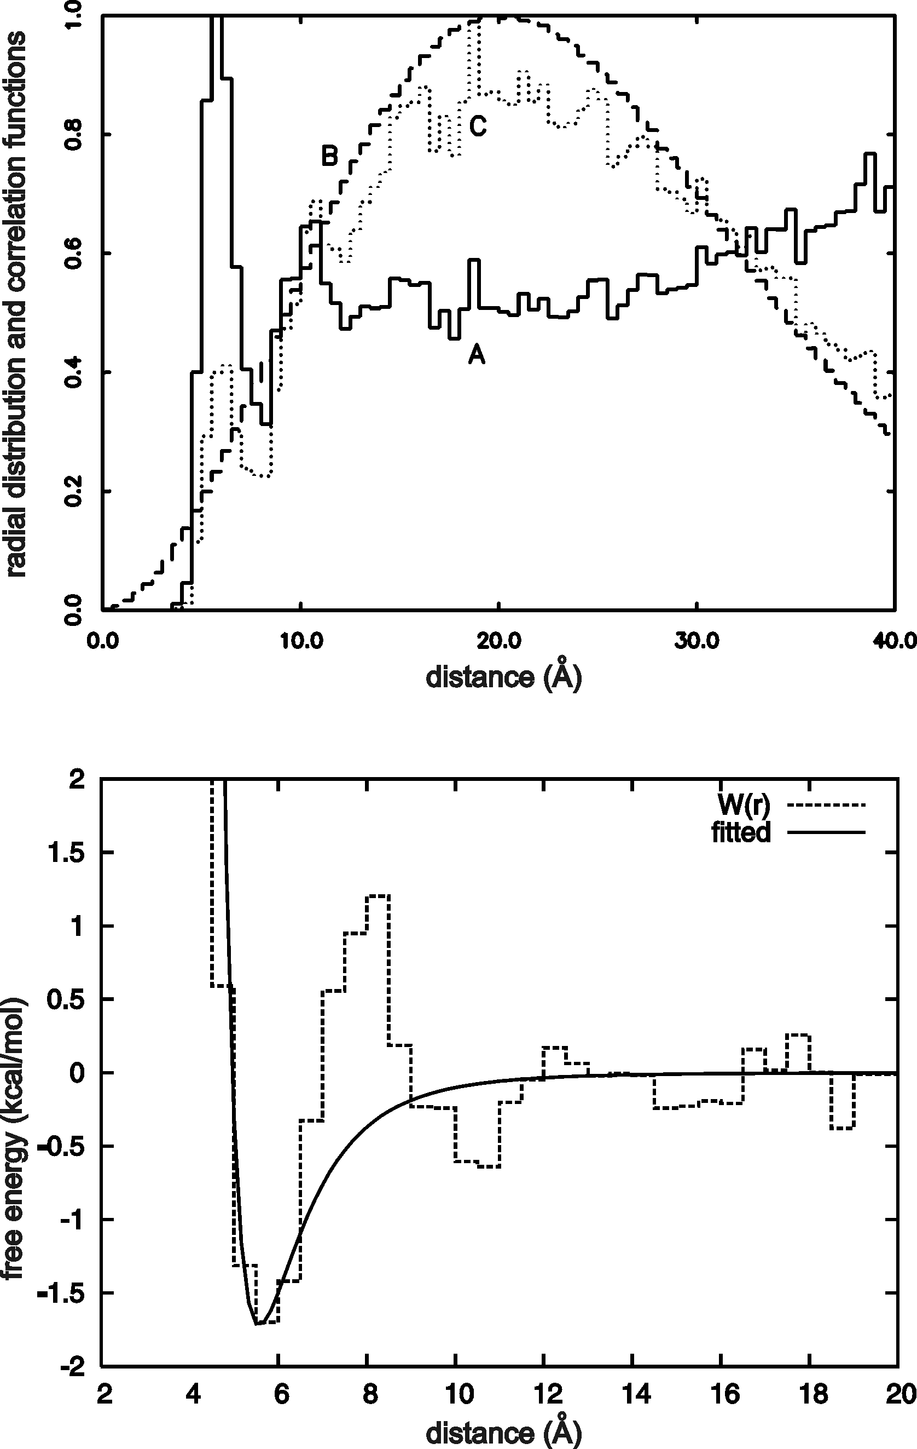
Statistical potentials
x – geometric variable
p – type(s) of site(s)
s – sequence context
Leu-Leu pair, statistics from PDB

Slide 3
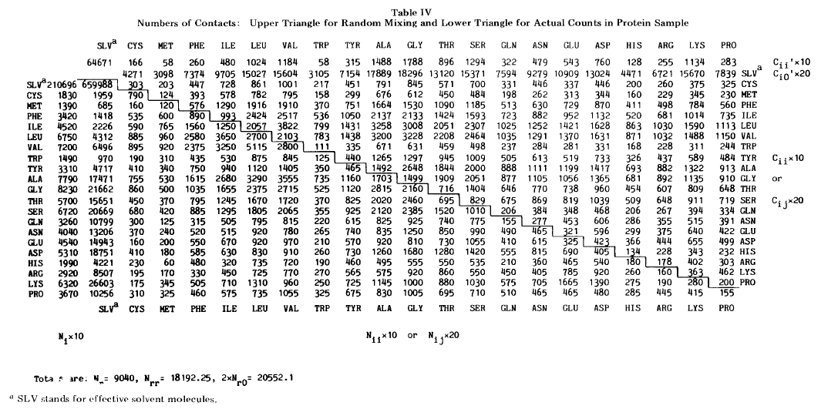
Contact potentials
S. Miyazawa, R. Jernigan, Macromolecules, 18, 534-552 (1985)

Slide 4
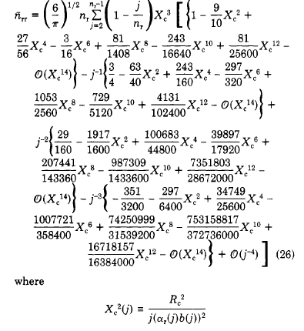
Estimating the reference number of contacts

Slide 5
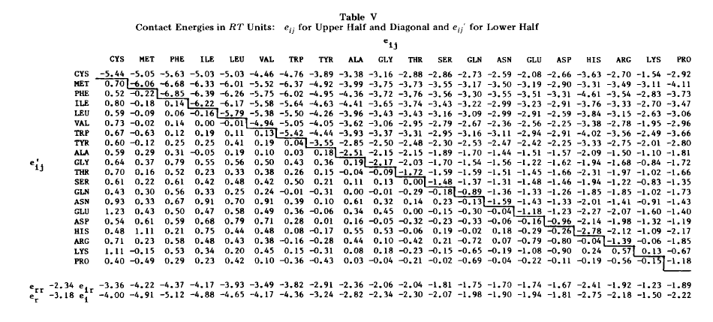
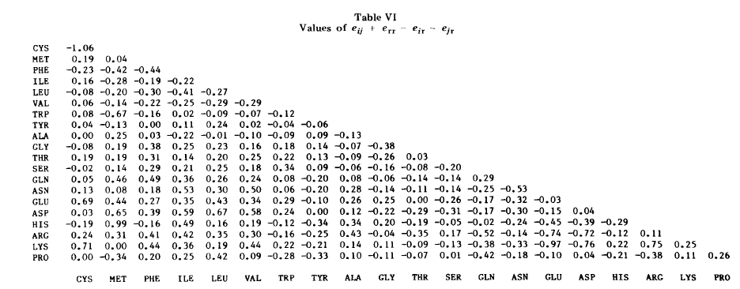

Slide 7
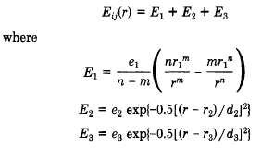

Slide 9
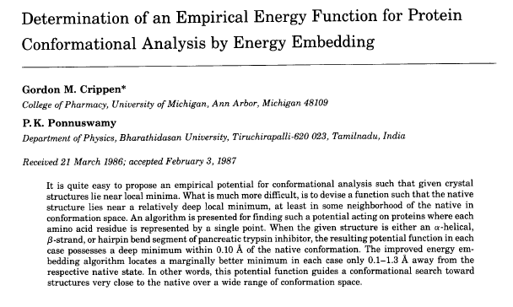

Slide 12
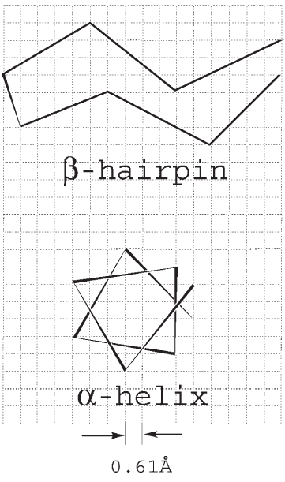
The CABS model
Koliński, Acta Biochim. Polon., 51, 347-351 (2004)

Slide 13
Features of CABS
Four interaction sites/residue (C^{α}, C^{β}, side chain center, peptide group.
High-resolution cubic-lattice representation of proteins.
Lattice Monte Carlo for sampling.
Sequence-independent short-range potentials.
Sequence-dependent short-range potentials.
Hydrogen-bonding potentials including correlation terms.
Sequence-independent excluded-volume long-range potentials.
Context-dependent long-range potentials of sidechain-sidechain interactions.

Slide 14
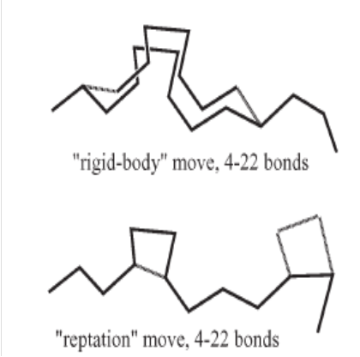
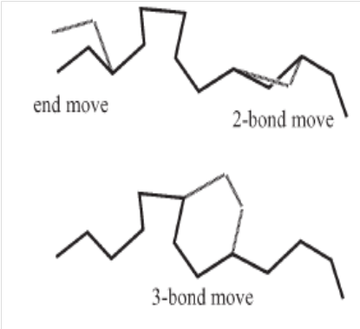
Moves in CABS

Slide 15


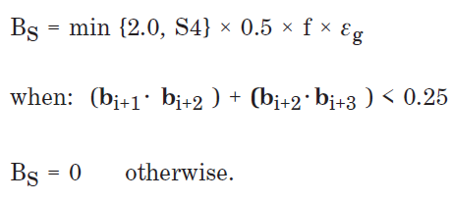
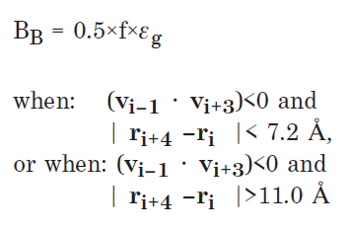
Sequence-independent short-range potentials
Stiffness

Slide 16
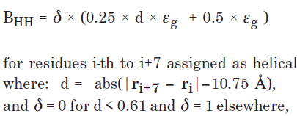


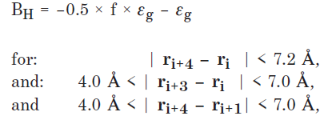
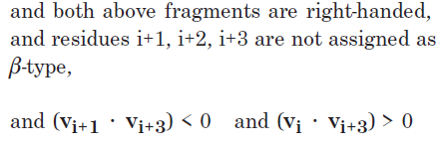
Sequence-independent short-range potentials
Secondary structure

Slide 17
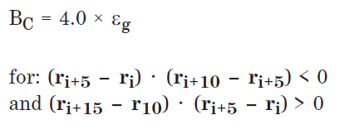
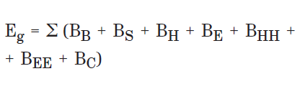
Sequence-independent short-range potentials
Preventing crumpled structures
Total energy from the generic short-range potentials

Slide 18
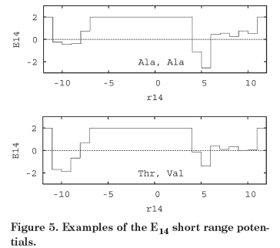
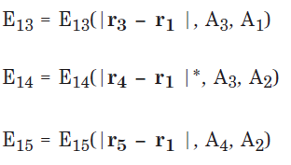

Sequence-specific short-range potentials in CABS

Slide 19
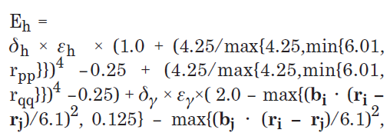

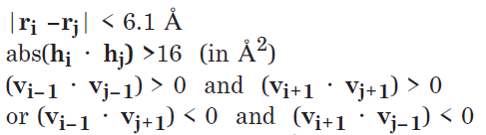
Hydrogen-bonding terms in CABS
H-bonding: multibody terms
Conditions for H-bonding

Slide 20
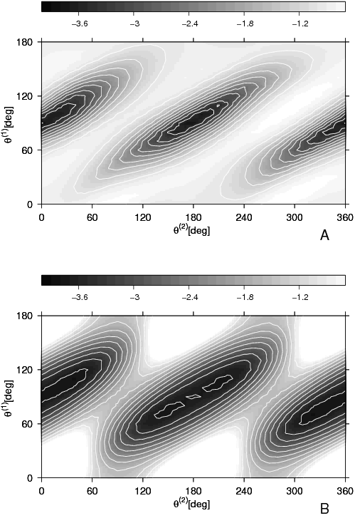
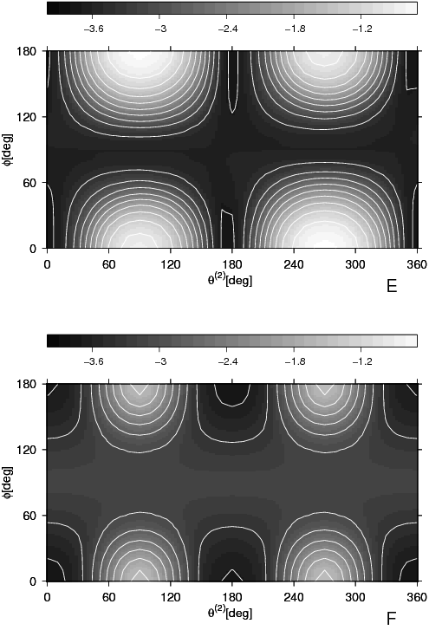
captures the orientation dependence of backbone hydrogen bonding interactions
Approx.
PMF
PMF
Liwo et al., Prot. Sci., 2, 1697 (1993); J. Phys. Chem. B 108, 9421 (2004)

Slide 21
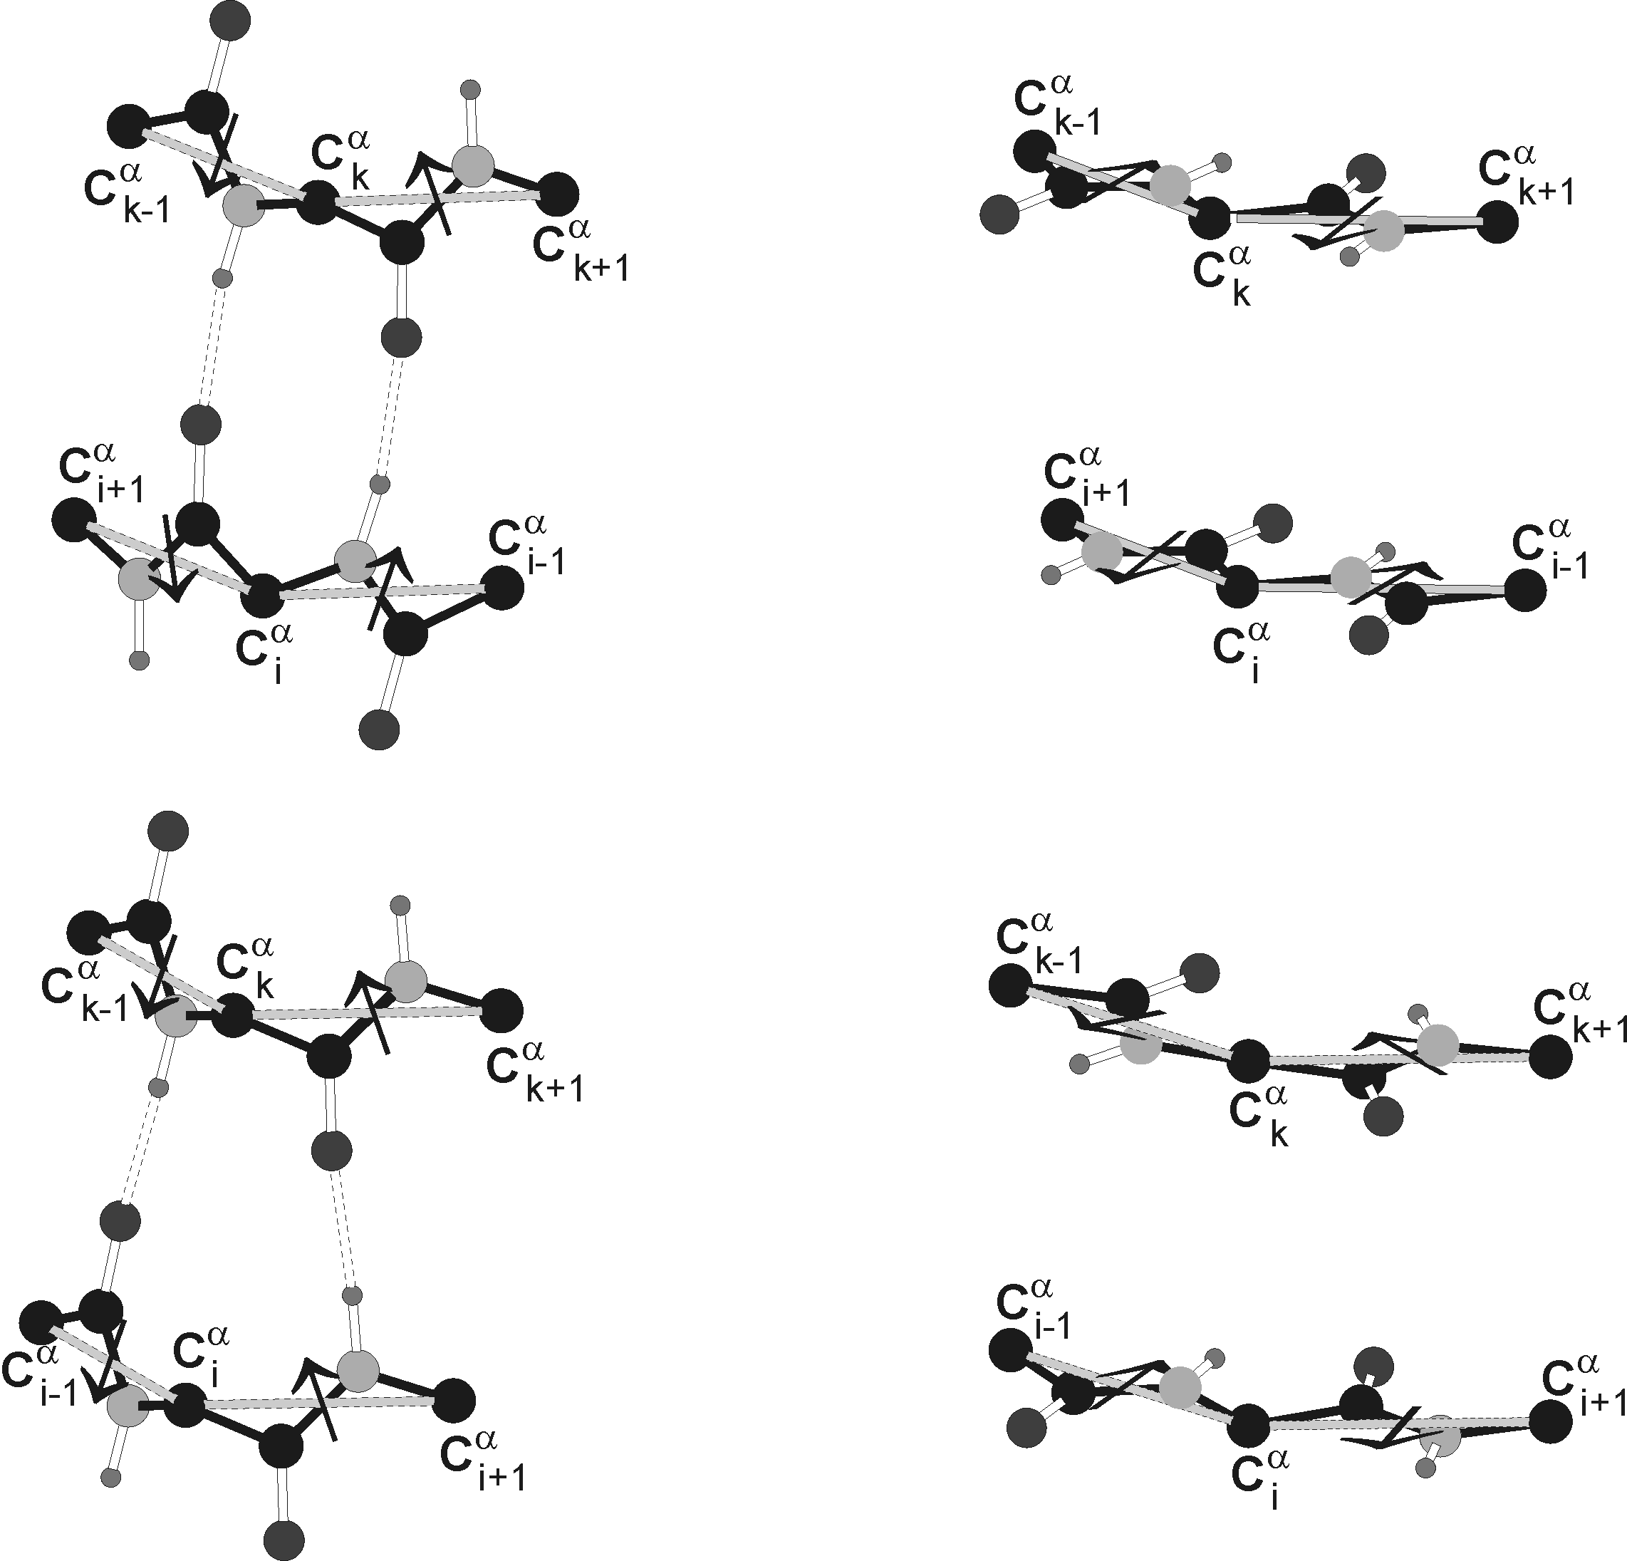
Illustration of the four-body terms in UNRES

Slide 22
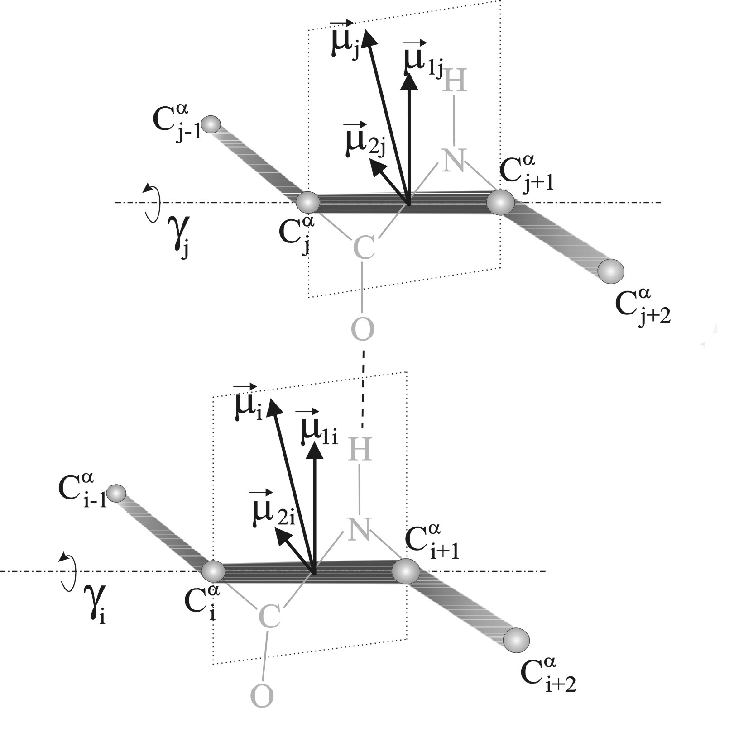
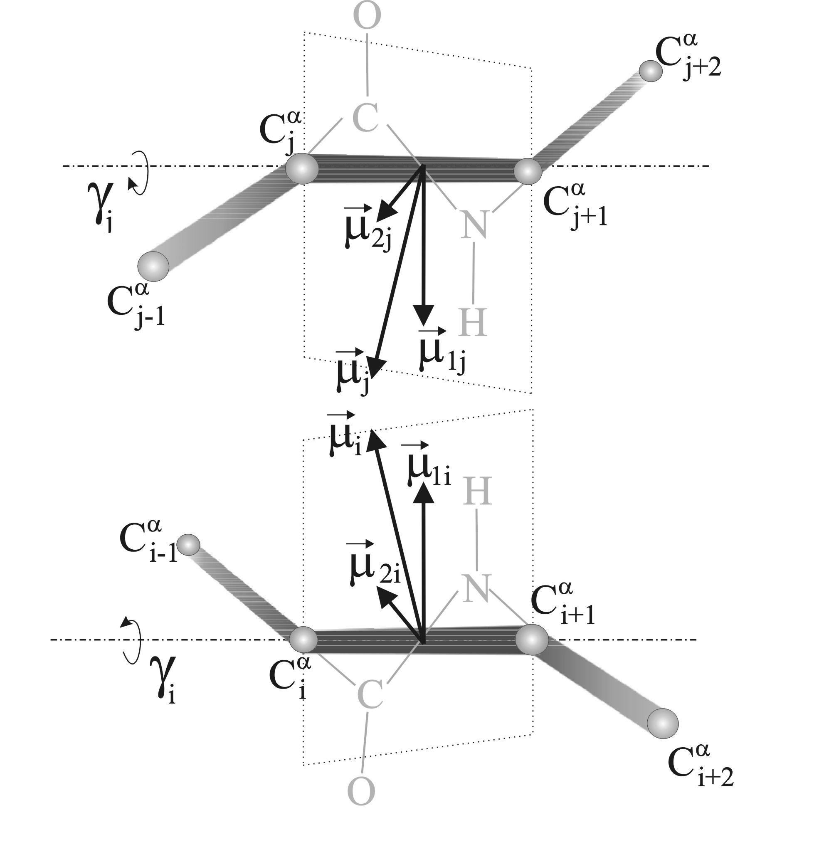
Illustration of the third-order correlation terms in UNRES

Slide 23


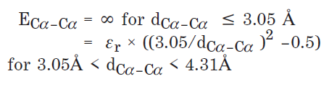
Generic repulsive interactions in CABS

Slide 24
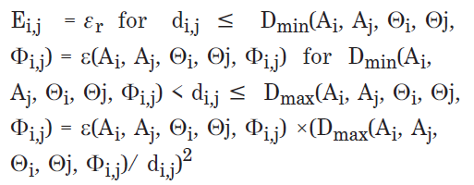

Long-range sequence-specific interactions in CABS

Slide 25
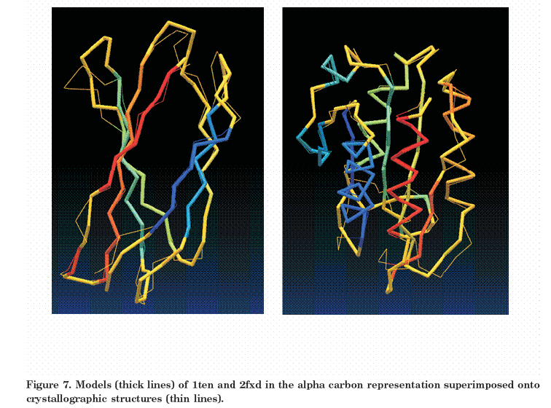
Protein structure prediction with CABS
1ten (thick: model)
2fxd (thick: model)

Slide 26
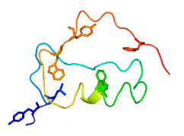
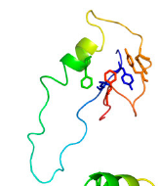
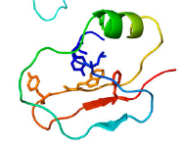
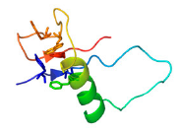
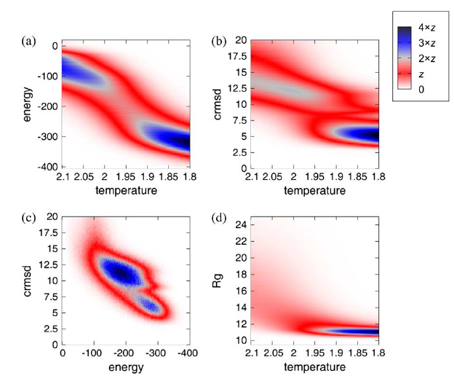
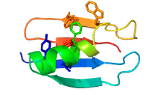
Protein folding simulations
Kmiecik and Koliński, Biophys. J., 94, 726-736 (2008)

Slide 27
CABS references
A. Koliński, A. Godzik, J. Skolnick, J. Chem. Phys., 98, 7420-7433 (1993) (the first version of the model, not yet CABS).
A Koliński, J. Skolnick, Proteins Struct. Funct. Genet., 18, 338-352; 353-366 (1994) (more about the model and preliminary application).
A. Koliński, Acta Biochim. Polon., 51, 347-351 (2004) (description of the CABS model).
S. Kmiecik, M. Kurcinski, A. Rutkowska, D. Gront, A. Kolinski, Acta Biochim. Polon., 53, 131–143 (2006) (denaturated states by CABS).
D. Gront, A. Koliński, Bioinformatics, 22, 621–622, 2006 (BioShell)
D. Latek, A. Koliński , J. Comput. Chem., 32, 536–44, (2011) (CABS-NMR)
M. Jamroż, A. Koliński, S. Kmiecik , Nucl. Acids Research, 41, W427-W431 (2013) (CABS Flex server)
M. Błaszczyk, M. Jamroż, S. Kmiecik, A. Koliński Nucl. Acids Research, 41, W406-W411, (2013) (CABS Fold server)
M. Kurciński, M. Jamroż, M. Błaszczyk, A. Koliński, S. Kmiecik Nucl. Acids Research, 43 (W1):W419-W424 (2015) (CABS Dock server).

