Slide 1
Lecture 14
Global minimization
of potential energy surfaces

Slide 2
Global minimization
Local minimization: find a minimum in the neighborhood of the current point.
Global minimization (optimization): find the point with the lowest function value.

Slide 3
Local minimzation:
currently used algorithms were designed in the 70th of XXth Century. They perform very well and are usually treated as a „black box”
Global minimization:
This is an NP-complete problem; the effort increases more than exponentially with the number of variables. Generally unsolvable

Slide 4
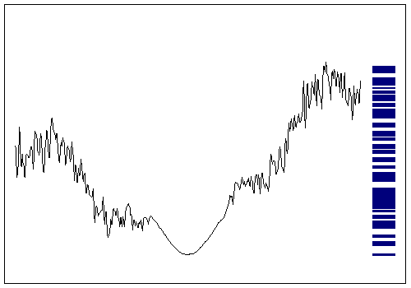
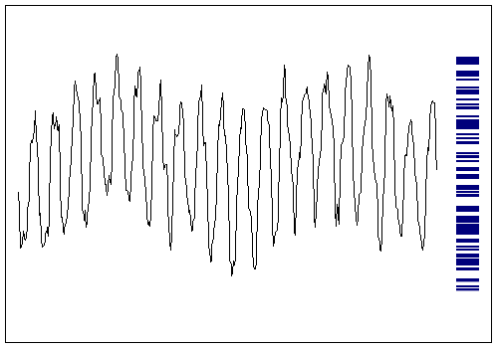
Global optimization is an NP-complete problem, generally unsolvable.
Practical algorithms can be designed if the function is searchable.
Searchable
Not searchable

Slide 5
Hierarchical structure of energy landscapes of Ac-(Ala)₈-NHMe with two versions of AMBER95 force field
constant ε
(well searchable)
distance-dependent ε
(weakly serarchable)
P. N. Mortenson and D. J. Wales J. Chem. Phys. 114, 6443-6454, 2001.

Slide 6
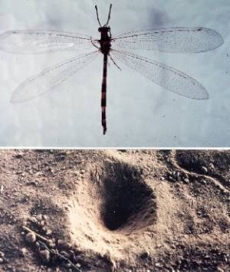
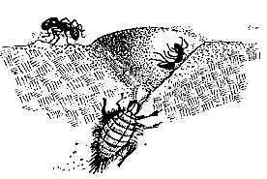
The stability of the structures of biological macromolecules results from special structure of their energy landscapes, which can be termed “minimal frustration” or “funnel-like structure”. A good example is the pit dug by antlion larva.

Slide 7

Degenerate minima
Where is the deepest point? (Everglades, Florida)

Slide 8

Non-degenerate minimum
Deepest point easy to find. (Morskie Oko, Poland)

Slide 9
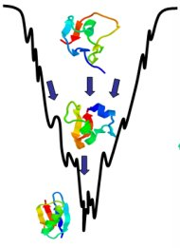
„Foldable” protein energy landscape

Slide 10
Global minimization methods
Deterministic algorithms
Grid search (good for up to 3 dimensions).
Build-up.
Deformation algorithms.
Stochastic algorithms
Canonical Monte Carlo/molecular dynamics.
Monte Carlo with Minimization (MCM) method.
Basin-hopping method.
Simulated annealing.
Genetic algorithms.

Slide 11
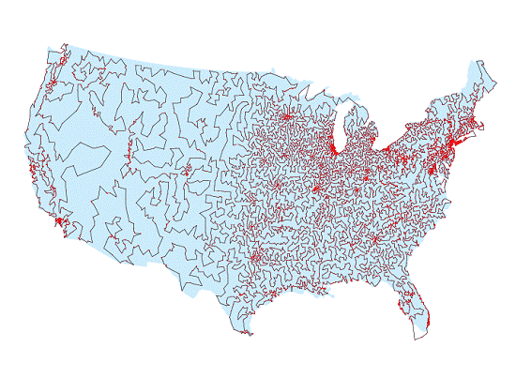
Traveling salesman problem
Find the route to distribute merchandise between all cities at the lowest cost.
This is an NP-complete problem

Slide 12
Deterministic methods

Slide 13
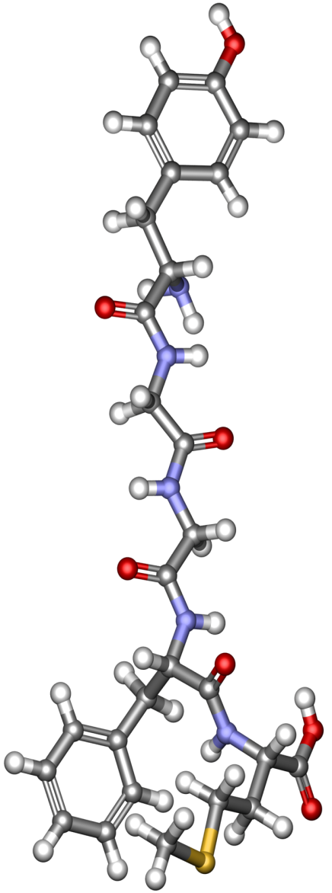
A scheme of the build-up method
Tyr
Gly
Gly
Phe
Met
Minimize dipeptide energy
select dipeptides with
Tyr
Gly
Gly
Phe
Met
Minimize tripeptide energy
select tripeptides with
Tyr
Gly
Gly
Phe
Met
Minimize energy of whole molecule
Nikiforovich, Shenderovich, Galaktionov, Bioorg. Khimiya

Slide 14
The structure of gramicidin S computed by the build-up method with the ECEPP/3 force field (M. Dygert, N. Go, H.A. Scheraga, Macromolecules, 8, 750-761 (1975). This structure turned out to be effectively identical with the NMR structure determined later.

Slide 15
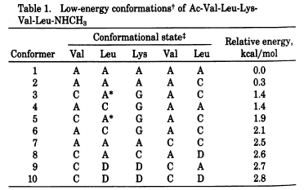
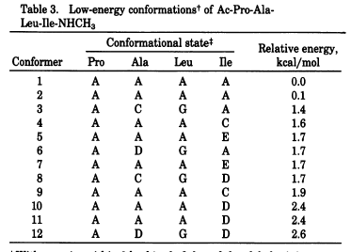
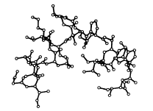
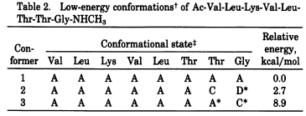
Conformation of melittin by build-up
H-GIGAVLKVLTTGLPALISWIKRKRQQ-NH₂ (26 residues)
Pincus and Scheraga, Proc. Natl. Acad. Sci. USA, 79, 5107-5110, 1982

Slide 16
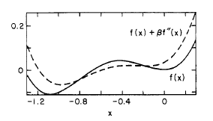
Diffusion equation method (DEM)
Adding the second derivative kills the higher-energy minimum.
We repeat te process for better efficiency:
But this is the solution to one-dimensional diffusion equation:

Slide 17
In general
Procedure:
Solve the diffusion equation for the system under study for t (deformation parameter) at which only one minimum remains.
Gradually reverse the transformation until t=0 (no deformation).

Slide 18
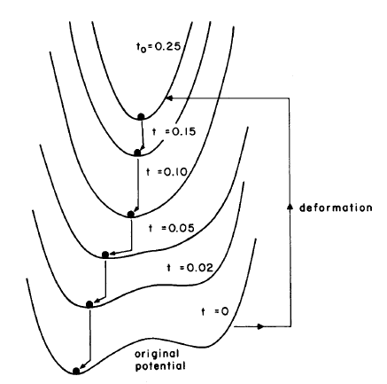
Piela, Kostrowicki, Scheraga, J. Phys. Chem., 93, 3339 (1989)

Slide 19
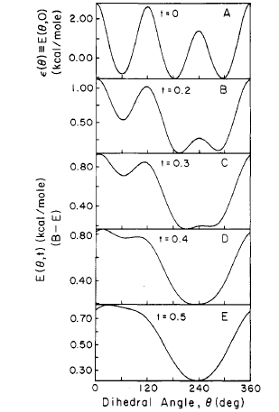
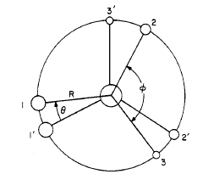
Initial application: pseudoethane molecule
Atoms interact with the LJ potential
Piela, Kostrowicki, Scheraga, J. Phys. Chem., 93, 3339 (1989)

Slide 20
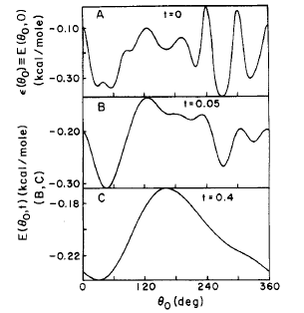
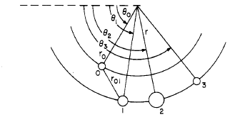
„Pendulum” (negative example)
Atoms can only rotate about the z axis of the coordinate system; they interact with LJ potentials.
Does not map the global minimum of the deformed function to the global minimum of the original function.
Piela, Kostrowicki, Scheraga, J. Phys. Chem., 93, 3339 (1989)

Slide 21
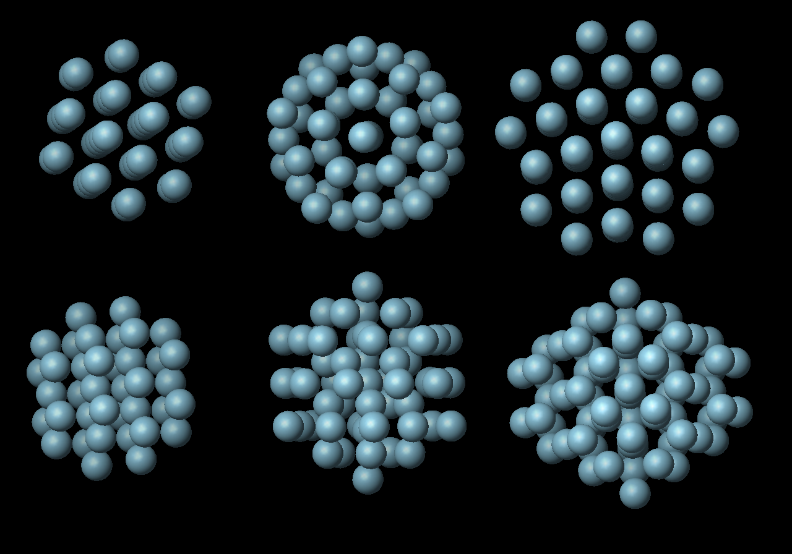
Lowest-energy clusters of argon atoms by DEM [Kostrowicki et al., J. Phys. Chem., 95, 4113-4119 (1991)].
N=38
(fcc)
N=55
(Mackay icosahedron)
N=75
(Marks dodecahedron)

Slide 22
Features of DEM
Theoretically elegant.
Difficult to implement for real energy functions and polymer chains.
Problems with singularities (energy tending to infinity for distances approaching zero; need to cut interactions).
Reversal procedure difficult to carry out because of bi- and n-furcations.
Easily outperformed by even simple stochastic methods.

Slide 23
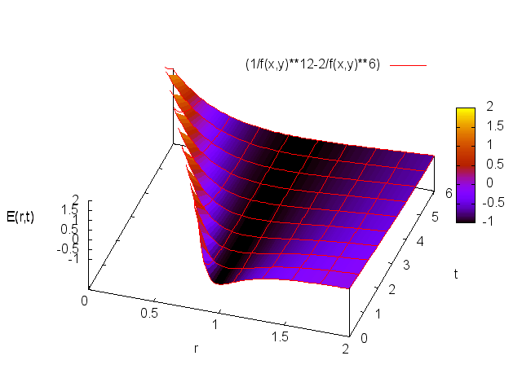
Simpler transformation of the original function
Distance-scaling method (DSM)
Pillardy, Olszewski, Piela, L. J. Phys. Chem. 96: 4337–4341 (1992).

Slide 24
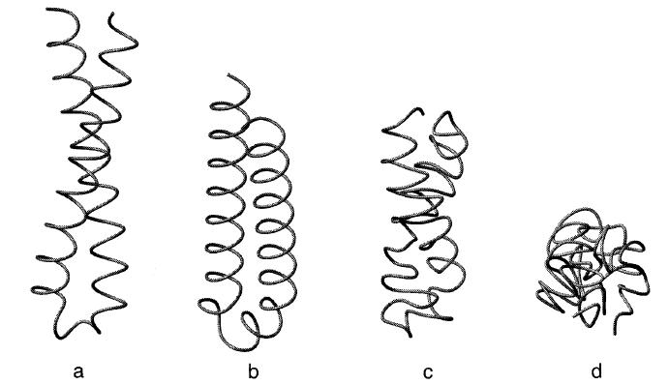
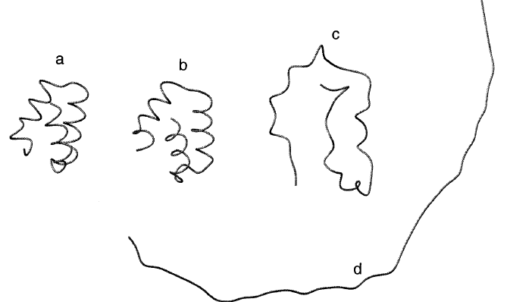
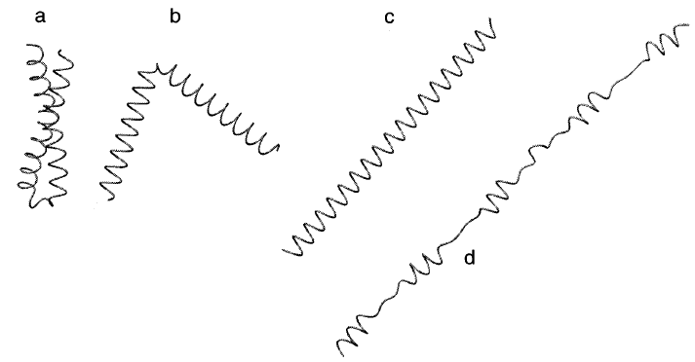
Global minima of polyalanine chains
with UNRES+DSM
b=1
b=2
b=2 for short-range interactions,
b=1 for long-range interactions
Pillardy, Liwo, Scheraga, J. Phys. Chem. B, 103, 7353-7366 (1999)

Slide 25
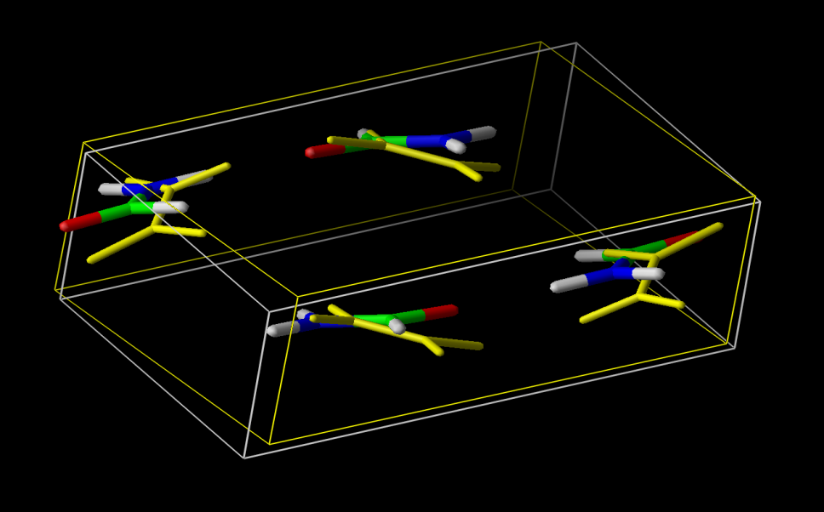
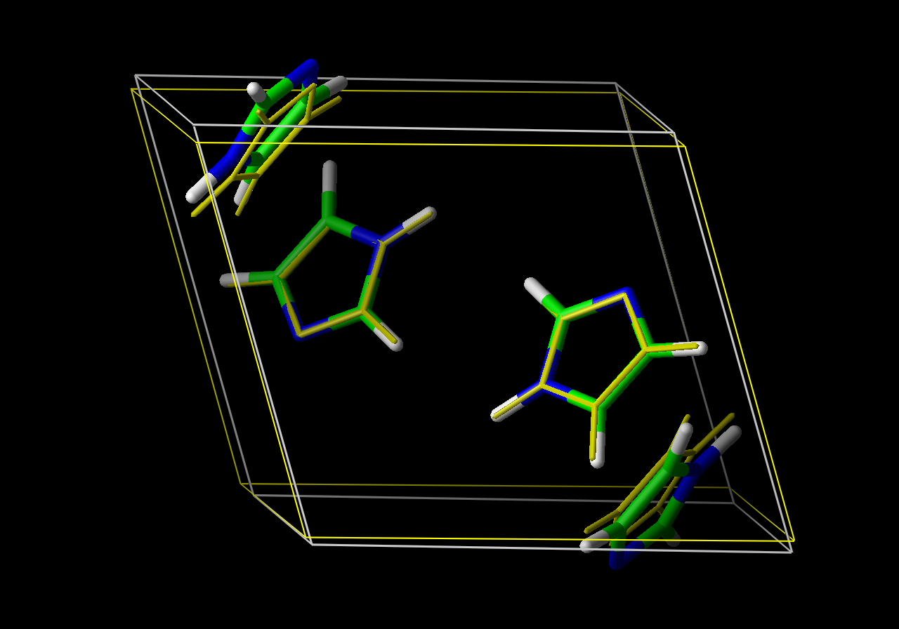
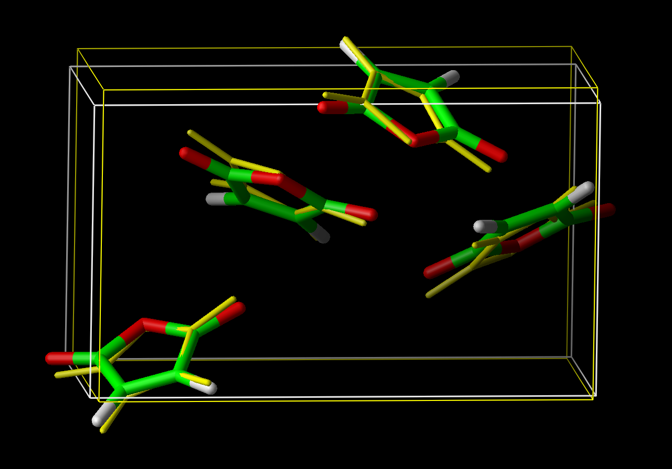
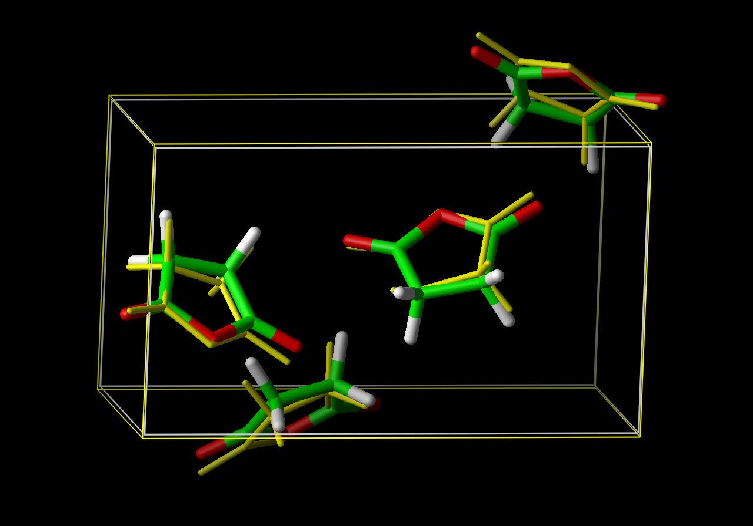
Comparison of experimental and computed crystal structure of small organic molecules obtained with the DSM method and AMBER force field Arnautova et al., J. Am. Chem. Soc. 122, 907-921 (2000)
Formamide
Imidazole
Maleic anhydride
Succinic anhydride

Slide 26
Stochastic methods

Slide 27
Monte Carlo-Minimization (MCM)
Generate the initial conformation and minimize its energy.
Perturb the conformation and minimize its energy (as opposed to canonical MC, perturbations are large).
Decide whether to accept/reject the new conformation:
  If E_{new}<E_{old}, accept, otherwise
  If ||R_{new}-R_{old}||<d, reject, otherwise
  Accept with probabilty of exp(-ΔE/kT).
Iterate from point 2.

Slide 28
Energy landscape mapping in MCM
Original function
MCM

Slide 29
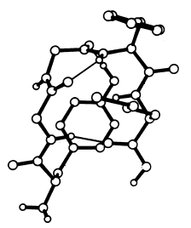
MCM for [Met5]enkephalin
Lowest-energy conformation compared to anything found previously by other methods.
Li and Scheraga, Proc. Natl. Acad. Sci. USA, 84, 6611-6615 (1987)

Slide 30
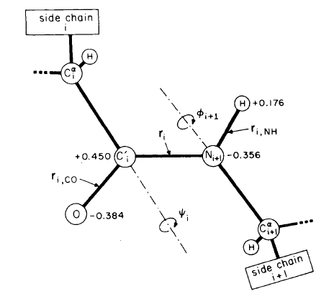
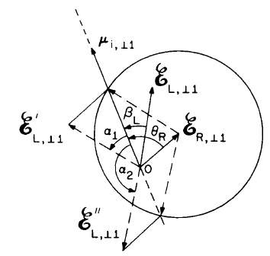
Electrostatically-driven Monte Carlo (EDMC)
Rotate the peptide group by φ and ψ angles to align its dipole moment with the electric field due to the whole protein
Piela and Scheraga, Biopolymers, 26, S33-S58 (1987)

Slide 31
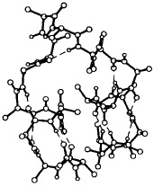
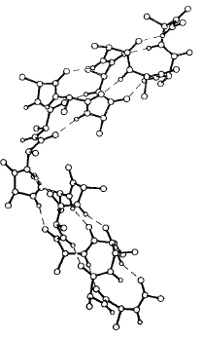
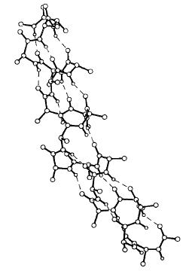
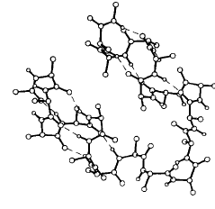
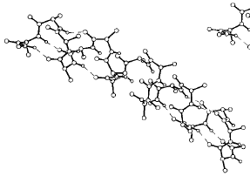
Two defects
Single defect
Before alignment
Before alignment
After alignment
First alignment
Piela and Scheraga, Biopolymers, 26, S33-S58 (1987)
Second alignment

Slide 32
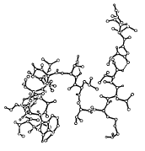
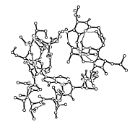
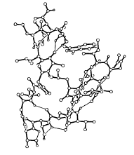
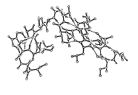
EDMC: test with melittin
Initial:
E=262.7 kcal/mol
Iteration 96:
E=-12.2 kcal/mol
Iteration 2800:
E=-60 kcal/mol
Lowest energy:
E=-82.6 kcal/mol
Ripoll and Scheraga, Biopolymers, 30, 165-196 (1990)

Slide 33
Conformational Space Annealing (CSA) method
N random
conformations
(parallelizable)
Energy mnimization
J. Lee, H.A. Scheraga, S. Rackovsky. J. Comput. Chem. 18, 1222-1232 (1997)
J. Lee, A. Liwo, H.A. Scheraga. PNAS. 96, 2025-2030 (1999).
Initial bank
copying
Update the bank; set D_{cut} D_{cut}=D_{cut}/2
bank
All seeds
used up?
Generate N random
conformations
and add them to the bank
Y
N
Global minimum
Found?
N
Y
stop
Choose M seeds
Generate N*M conformations from seeds
by genetic operations
Energy minimization
(parallelizable)

Slide 34
Genetic operations in CSA
Importing one dihedral angle from a „seed” conformation to the target conformation.
Importing two consecutive angles.
Importing a section of structure (α-helix, β-sheet, etc.)

Slide 35
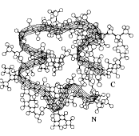
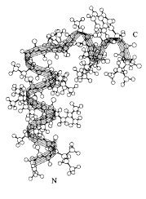
CSA: test with melittin
Lowest-energy conformation
E=-92.1 kcal/mol
Lowest-energy conformation found by EDMC
E=-86.4 kcal/mol
Lee, Scheraga, Rackbovsky, Biopolymers, 46, 103-115 (1998)

Slide 36
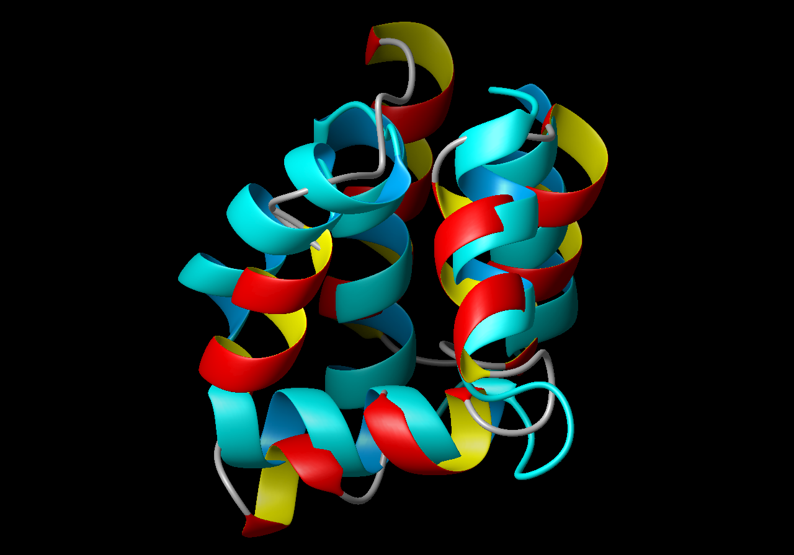
Comparison of computed structure of bacteriocin AS-48 from E. faecalis (Pillardy et al., Proc. Natl. Acad. Sci. USA., 98, 2329-2333 (2001)) with the experimental structure.

