Slide 1
Molecular dynamics (1)
Principles and algorithms

Slide 2
Equations of motion
Solving the equations of motions results in a microcanonical ensemble (energy is conserved).

Slide 3
Lyapunov instability of trajectories
For 3- and more body systems interacting via central forces, an infinitesimably small perturbations of the initial conditions results in FINITE trajectory change after sufficiently long time

Slide 4
Simplistic (Euler) algorithm

Slide 5
The Verlet algorithm: derivation:

Slide 6
The velocity-Verlet algorithm
Step 1:
Step 2:

Slide 7
Relation to the Verlet algorithm

Slide 8
The leapfrog algorithm
Relation to the Verlet scheme

Slide 9
The three algorithms discussed are variants of the same algorithm.
All three algorithms are reversible in time; if run backward for the same time they restore the starting point.
All these three algorithms have the symplectic property: the total energy oscillates about a value close to the initial total energy (the shadow Hamiltonian). Higher-order algorithms (e.g., the Gear algorithm don’t have this property.

Slide 10
Time dependence of the potential, kinetic, and total energy of the Ac-Ala₁₀-NHMe (Khalili et al., J. Phys. Chem. B, 2005, 109, 13785-13797)
Kinetic energy
Energy [kcal/mol]
Total energy
Potential energy
Total energy
0.0 1.0 2.0 3.0 4.0 5.0
time [ns]

Slide 11


The Gear predictor-corrector algorithm (4th order)
c₀=3/8, c₁=1, c₂=3/4, c₃=1/6: correction coefficients;

Slide 12
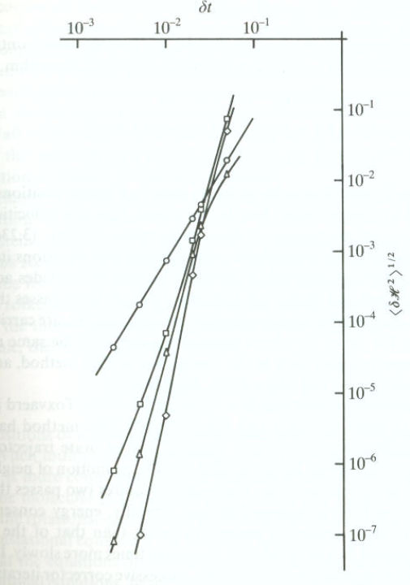
Energy error for various integration algorithms
Verlet
Gear
4th order
Gear
5th order
Gear
6th order

Slide 13
MD simulation procedure
Generate a low-energy initial configuration (minimize the potential energy of the system).
Generate initial velocities of the atoms.
Run simulation; monitor the properties that need to be (approximately) conserved.

Slide 14
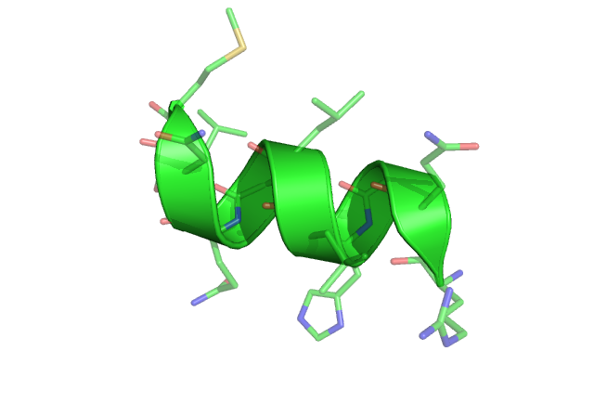
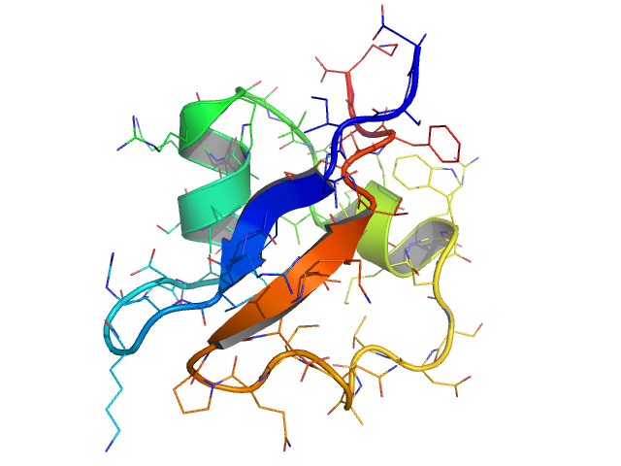
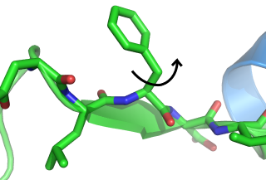
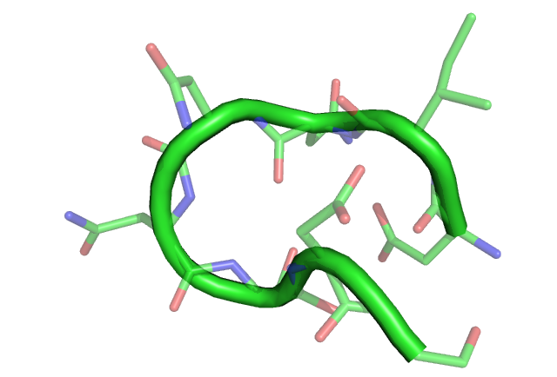
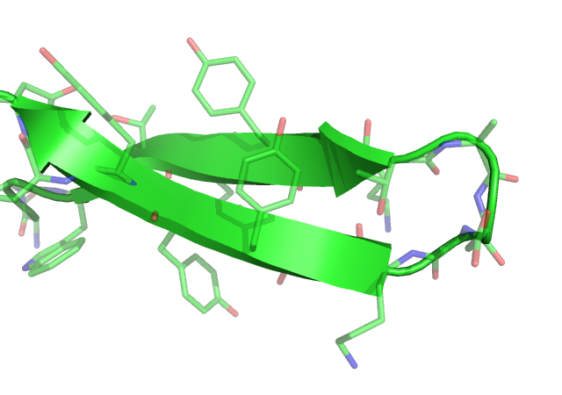
sidechain
rotation
helix
formation
protein
folding
10⁻¹⁵
femto
10⁻¹²
pico
10⁻⁹
nano
10⁻⁶
micro
10⁻³
milli
10⁰
seconds
bond
vibration
loop
closure
folding of
β-hairpins
all atom MD step

Slide 15
Time step Δt for some standard MD packages
MD Package | Explicit Solvent | Implicit Solvent
AMBERª | 1 fs (20 fs on ANTON; good symplectic algorithms) | 2 fs
CHARMM^{b} | 3 fs | 4-5 fs
TINKER^{c} | 1 fs | 2 fs
ª http://amber.scripps.edu/
^{b} http://www.charmm.org/
^{c} http:// dasher.wustl.edu/tinker/

Slide 16
Why are the Verlet-like algorithms symplectic?
We consider an arbitrary function that depends on coordinates and momenta.
Its time derivative is
We define the Liouville operator:

Slide 17
Thus f(t) can formally be written as:

Slide 18
If we consider only the first part:
For the second part:

Slide 19
However, the two parts of the Liouville operator don’t commute and, consequently

Slide 20
However, we have (the Trotter identity):

Slide 21
Now we apply the approximate Liouville operator to positions and momenta:
Step 1:

Slide 22
Step 2:

Slide 23
Step 3:

Slide 24
This is exactly the velocity-Verlet algorithm
By splitting the exponent of the Liouville operator another way we obtain the leapfrog algorithm

Slide 25
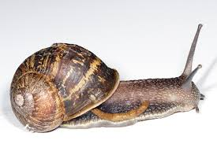

Establishing the time step
safe = very small =
very small progress
large = flying blind=
risk

Slide 26
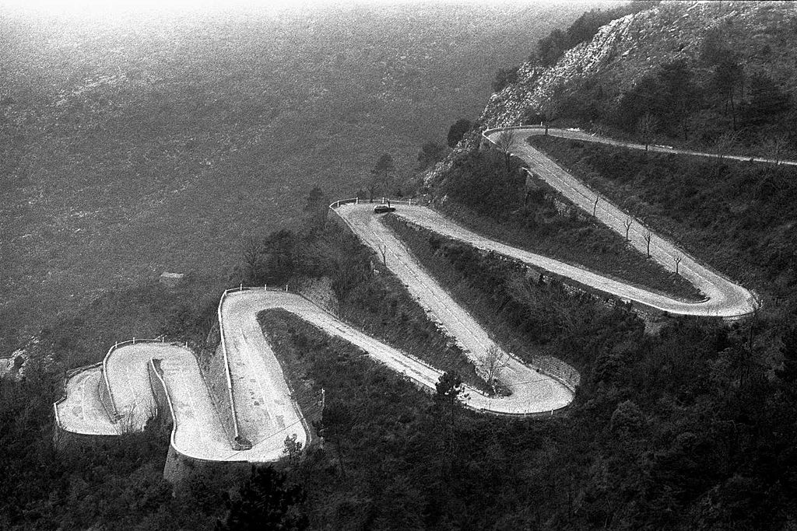
French Alps „Col de Braus-small” author Ericd. License CC BY-SA 3.0

Slide 27
Crude solution:
In a given time step, we reduce Δt until the change acceleration is sufficiently small
DISADVANTAGE: time reversibility is lost

Slide 28
Refined solution: time-split algorithms
Identify the forces F_{L} that vary „slowly” (e.g., electrostatic forces) and F_{S} that vary „fast” (e.g., the sort-range repulsive forces). Then write the Liouville operator as follows:

Slide 29
Then we split the Liouville operator in the following way:
This algorithm is time-reversible if the splitting number m is not changed during the course of the simulation.

Slide 30
References to integration algorithms
Frenkel, D.; Smit, B. Understanding molecular simulations, Academic Press, 1996, chapter 4.
D.C. Rapaport. The art of molecular dynamics simulation, Cambridge University Press, 1995.
Calvo, M. P.; Sanz-Serna, J. M. Numerical Hamiltonian Problems; Chapman & Hall: London, U. K., 1994.
Verlet, L. Phys. Rev. 1967, 159, 98.
Swope, W. C.; Andersen, H. C.; Berens, P. H.; Wilson, K. R. J. Chem. Phys. 1982, 76, 637.
Tuckerman, M.; Berne, B. J.; Martyna, G. J. J. Chem. Phys. 1992, 97, 1990.
Ciccotti, G.; Kalibaeva, G. Philos. Trans. R. Soc. London, Ser. A 2004, 362, 1583.

Slide 31
Temperature control (Berendsen thermostat)
: velocities reset to maintain the desired temperature
: microcanonical run
f – #degrees of freedom (3n)
τ – coupling parameter
Δt – time step
E_{k} – kinetic energy

Slide 32
Pressure control (Berendsen barostat)
L – the length of the system (e.g., box sizes)
β – isothermal compressibility coefficient
τ – coupling parameter
Δt – time step
p^{ext} – external pressure

