Slide 1
Van der Waals forces and hydrogen bonds
J. Israelichvili, „Intermolecular and Surface Forces”, Academic Press, London, 1997

Slide 2
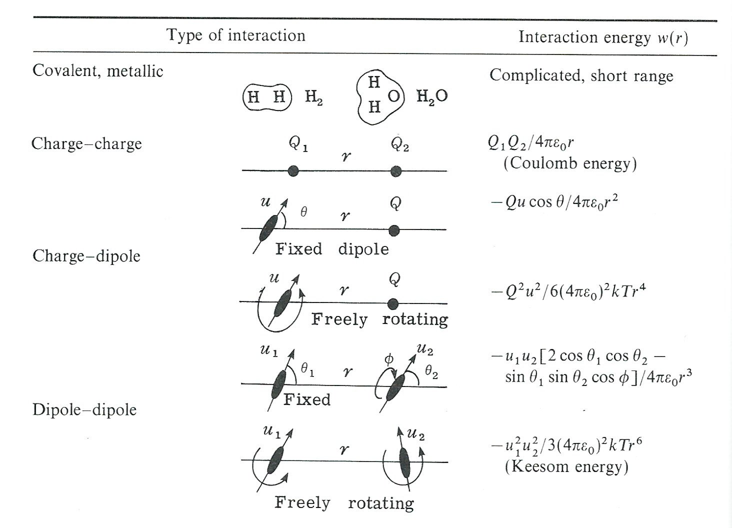
Types of „weak” interactions

Slide 3
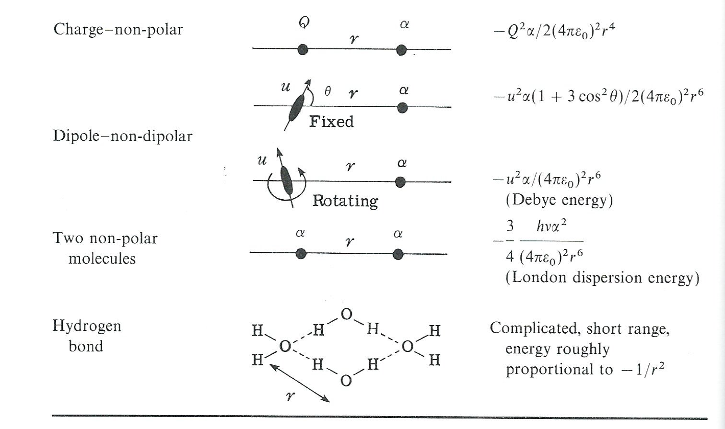
Types of „weak” interactions (continued)

Slide 4
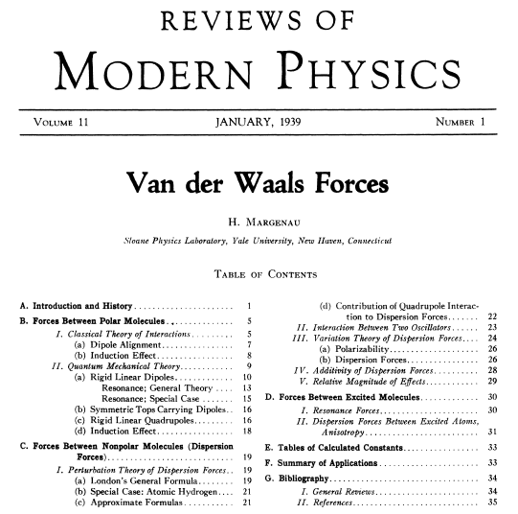

Slide 5
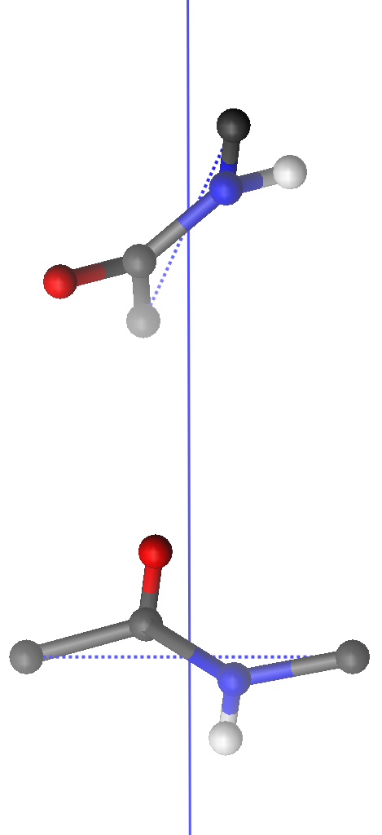
Interactions between backbone peptide groups
λ_{j}
C^{α}_{j+1}
μ_{j}
p_{j}
C^{α}_{j}
μ_{i}
λ_{i}
p_{i}
C^{α}_{i}
C^{α}_{i+1}

Slide 6
O
C
C
C
N
H
insignificant

Slide 7
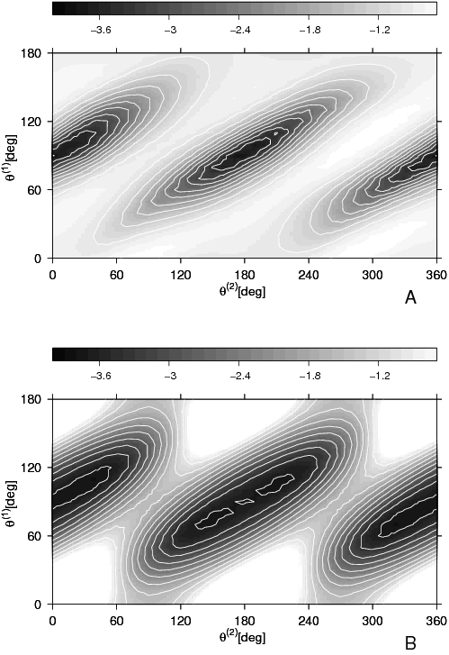
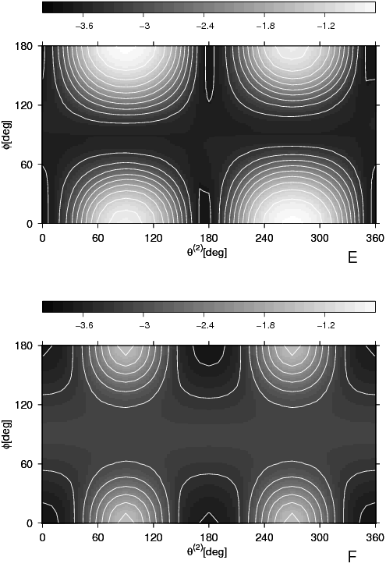
captures the orientation dependence of backbone hydrogen bonding interactions
Approx.
PMF
PMF
Liwo et al., Prot. Sci., 2, 1697 (1993); J. Phys. Chem. B 108, 9421 (2004)

Slide 8
Dispersion forces

Slide 9
QM (London, 1930)
Different atoms

Slide 10
Repulsive potentials

Slide 11
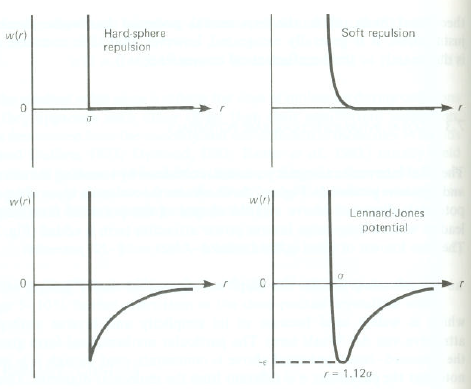

Slide 12
What are hydrogen bonds?
δ⁺
H
δ⁻
X
Y
θ
X, Y are usualy (99% or so) electronegative atoms
θ is usually close to 180º
d(X …Y) < r_{VDW}(X)+r_{VDW}(Y); d(H…Y)<r_{VDW}(H)+r_{VDW}(Y)
d(X-H) is greater than in the free X-H molecule
δ⁺H and δ⁻Y are pronounced wrt non-interacting molecules

Slide 13
r_{VDW}(O)=1.52 A
r_{VDW}(H)=1.09 A

Slide 14
Types of hydrogen bonds
Weak (ΔH<1 kcal/mol) usually involve non-polar or weakly polar groups.
Moderately strong (1<ΔH<20 kcal/mol) involve polar groups.
Strong (ΔH>20 kcal/mol) involve ions.

Slide 15
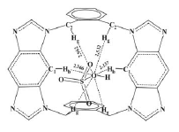
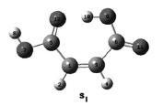
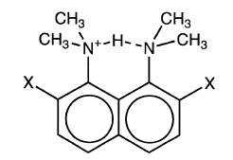
Examples
weak
moderately strong
strong

Slide 16
H-bonds in proteins
backbone-backbone
backbone-sidechain
sidechain-sidechain
backbone-solvent
sidechain-solvent

Slide 17
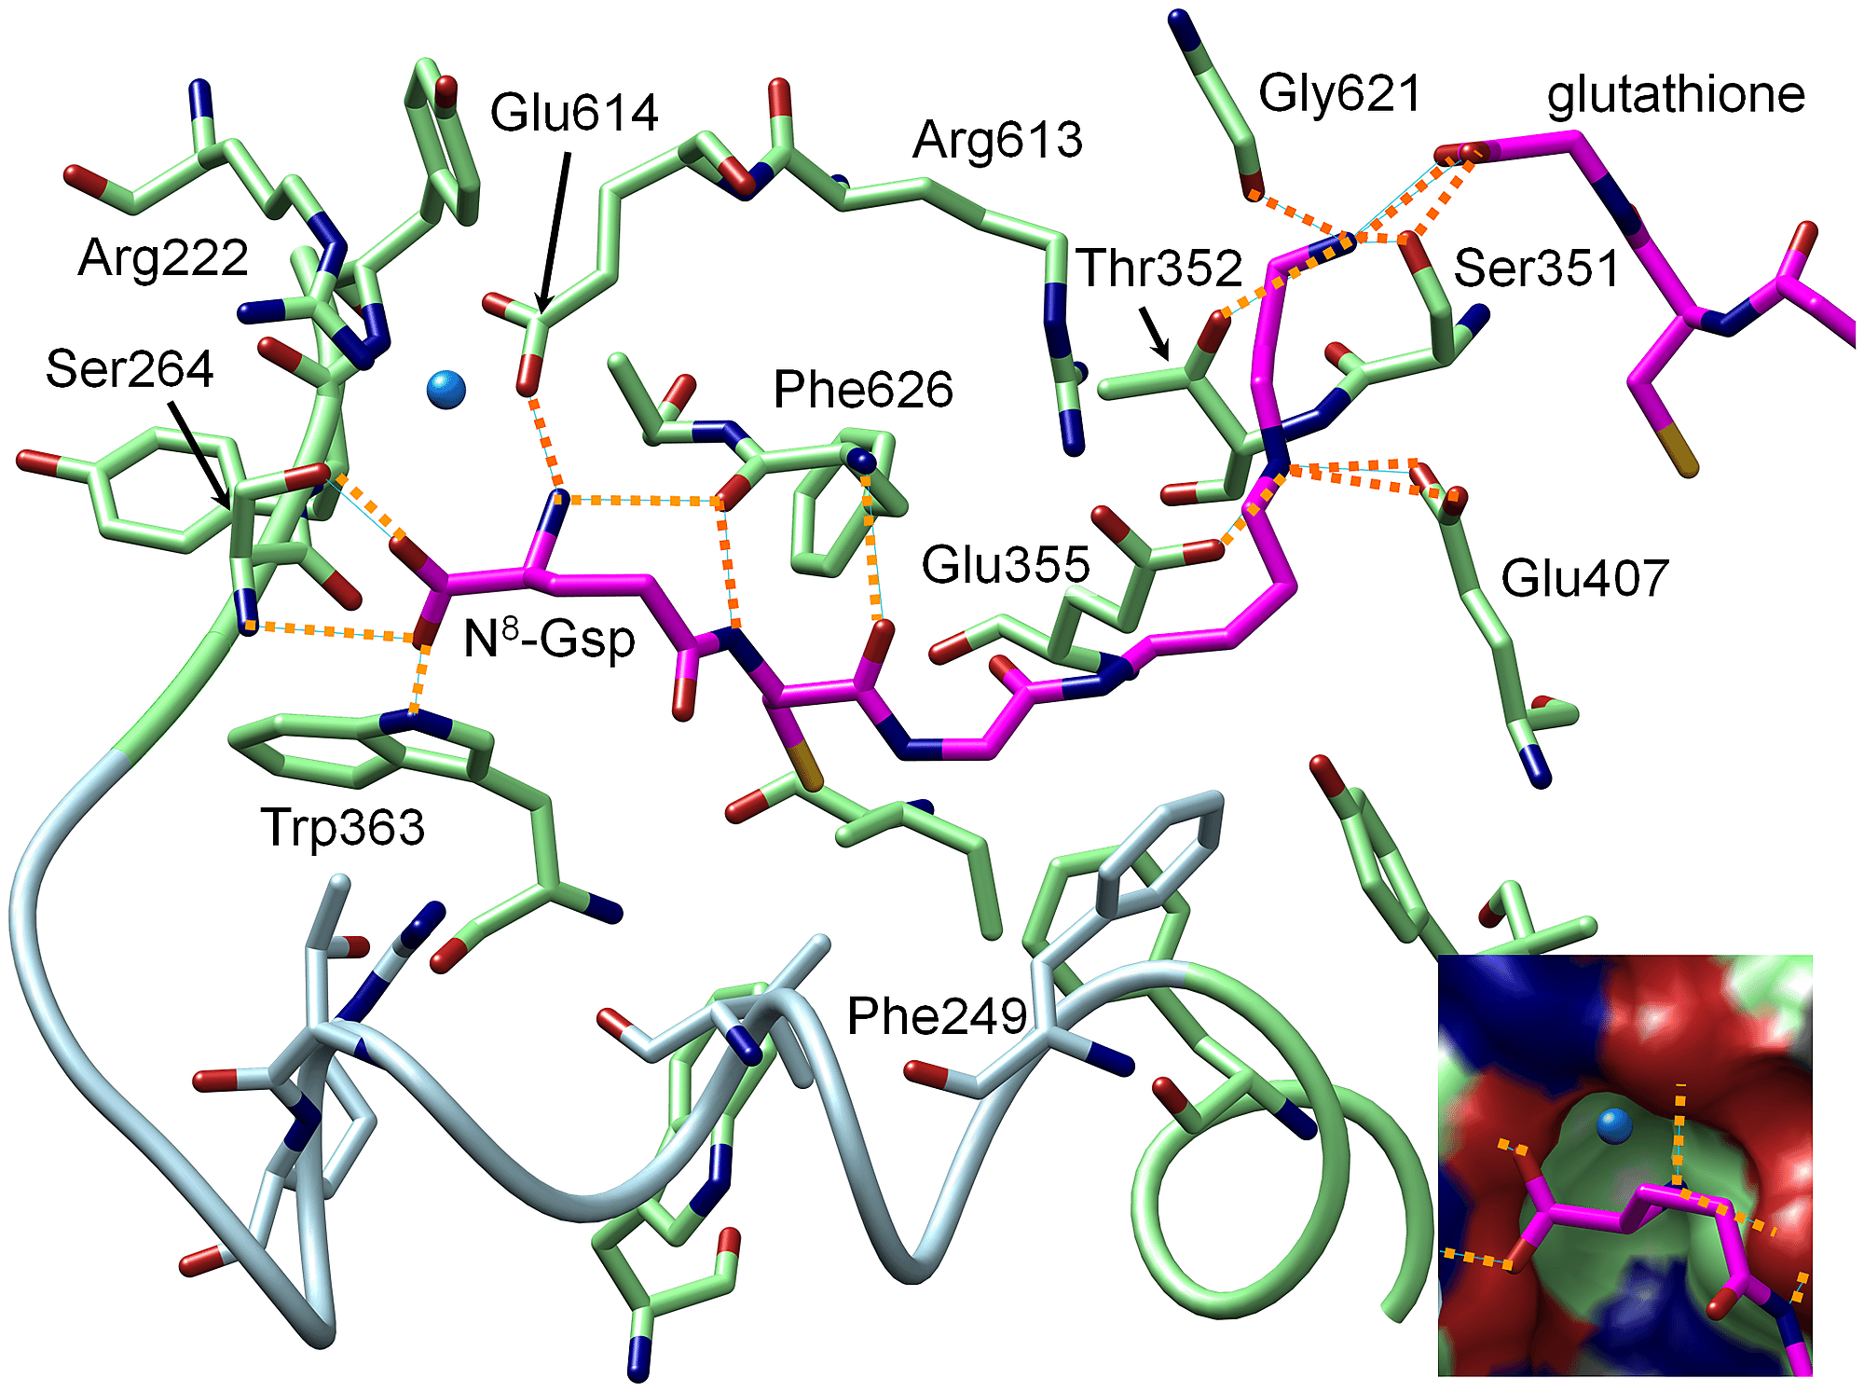
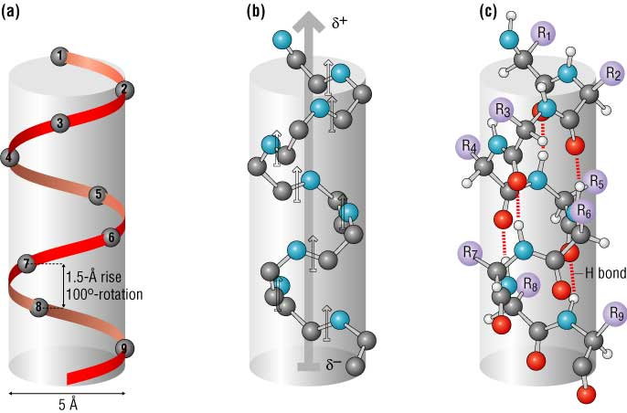
Examples

Slide 18
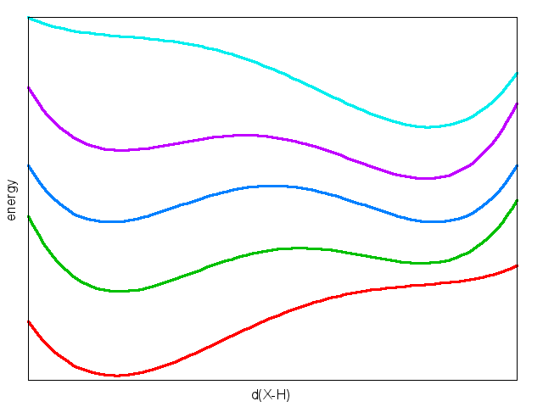
Hydrogen bonding and proton transfer
polarity
X-H…Y
X⁻…H-Y⁺
X
H
Y

Slide 19
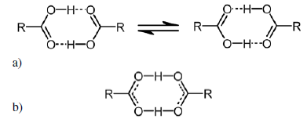
Symmetric hydrogen bonds
Kojić-Prodić & Molcanov, Acta Chim. Slov., 2008, 55, 692-708

Slide 20
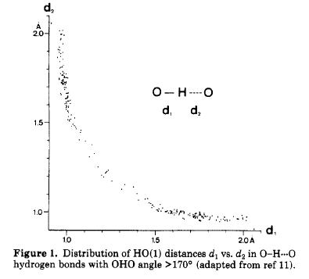
H-bonding energy surfaces are reflected in structural structures
H.B. Burgi, J.D. Dunitz, Acc. Chem. Res., 1983, 16, 153-161

Slide 21
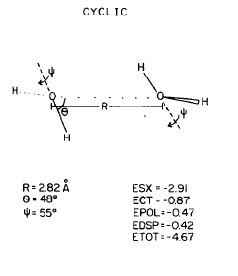
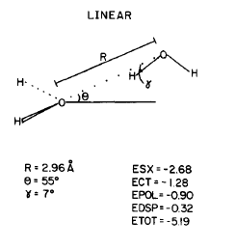
Energy decomposition
E=E_{SX}+E_{POL}+E_{CT}+E_{DISP}
E=E_{ES}+E_{XC}+E_{POL}+E_{CT}
Singh and Kollman, J. Chem. Phys., 1985, 83, 4033-4040

Slide 22
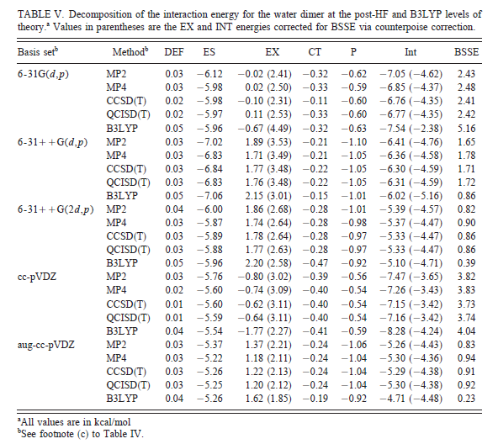
Korochowiec et al., J. Chem. Phys., 2000, 112, 1623-1632

